Slide 1
Magnetic Flux Quantization in Double Layer Exciton Superfluids
Louk Rademaker, Leiden University
DRSTP SPTCM School, 12 April 2010
Notes:
Welcome everyone.
I’m Louk Rademaker, I started my PhD research one year ago in Leiden in the group of Jan Zaanen, as part of a large research project led by the experimentalist Hans Hilgenkamp at the University of Twente. The projects studies exciton condensation in heterostructures, and I will do the theoretical part of that project. So no worries, this will be a completely theoretical talk!
(Note to myself: 5 slides-with-content, each 2 minutes. 1 minute introduction, 1 minute conclusion. Total: 12 minute, +3)

Slide 2
Outline
What are double layer exciton superfluids?
Ginzburg-Landau theory: from U(1) to SU(2)
Two physical results
Diamagnetism
Flux quantization
Notes:
I want to start with an outline of what I am about to tell you.
In the introductory part, I will tell you what I mean with “double layer exciton superfluids”.
The second part will constitute the theoretical body of my presentation: the Ginzburg-Landau theory of these superfluids.
In the concluding part I will derive two physical, observable results that follow immediately from the Ginzburg-Landau order parameter theory.
Time Introduction: 46 seconds

Slide 3
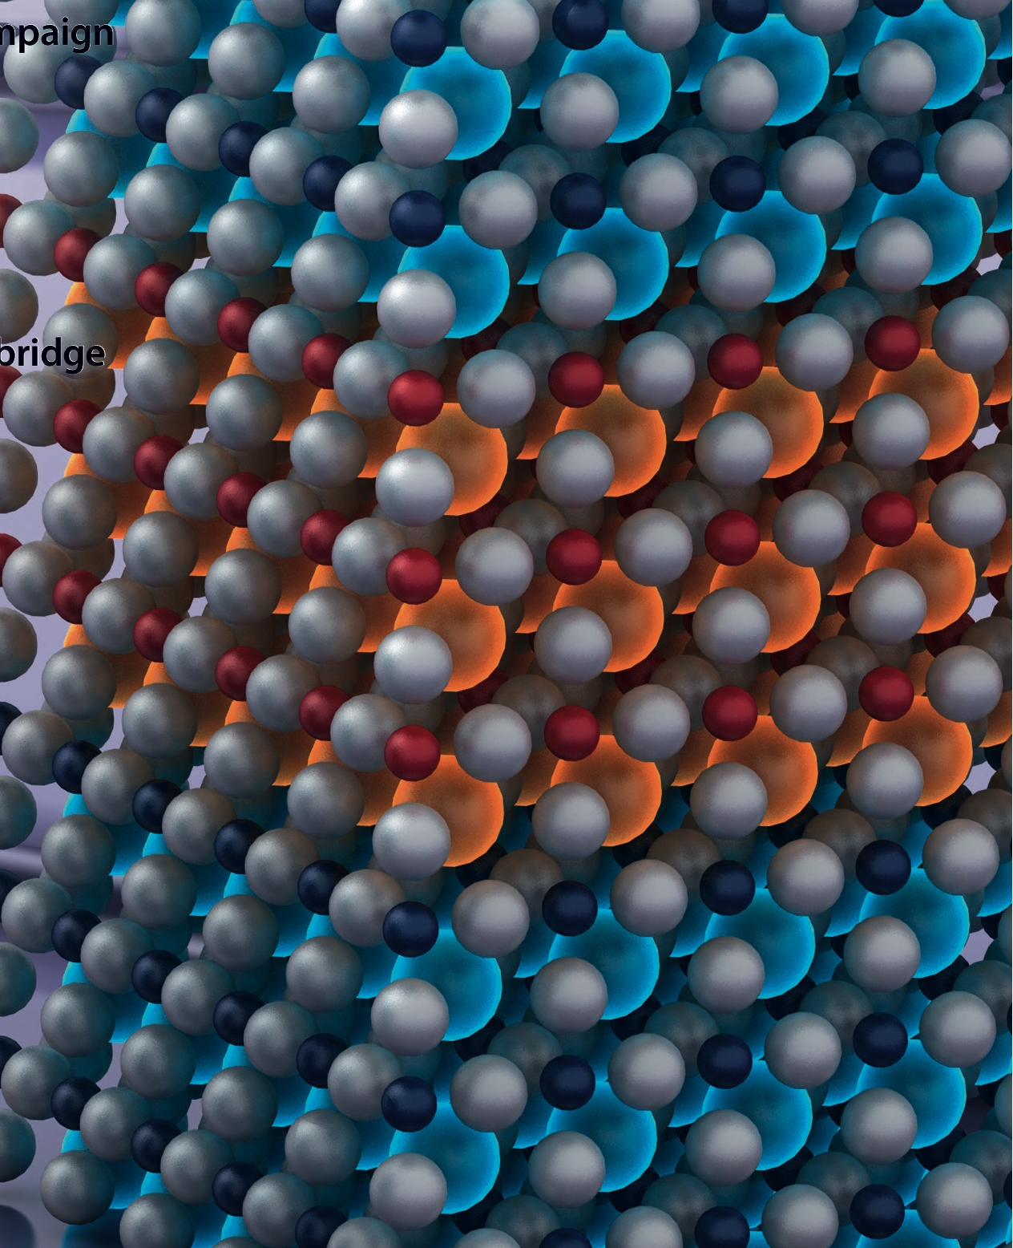
Double Layer Exciton Superfluids
Electron + Hole = Exciton = Boson
Bosons can form BEC = Superfluidity
Double Layer = Electron-Hole Separation
Hilgenkamp: complex oxides
Notes:
So first I will answer the question: What do I mean with “Double layer exciton superfluids”?
To start: yes, “exciton” is a ridiculous name, because in essence all particles are “excitations”. But as you know, with “exciton” we only mean the bound state of an electron and a hole. These excitons are bosons and can form a Bose-Einstein condensate at low enough temperatures.
The excitons that we study consist of electrons and holes that are confined to spatially separated layers. So I have one layer with electrons, and one layer where holes are the free charges, separated by an insulating layer.
I must emphasize however, that we are not interested in photo-excited excitons. We only want systems where the electron and hole concentration in each layer are in equilibrium. We also don’t mean the quantum Hall bilayers (some of you did research in this field).
These systems can be composed of, for example, graphene. A new proposal done by Hans Hilgenkamp, my supervisor from Twente, is to make these double layers out of complex oxides.
But it is important to note that these systems are not realized yet, which makes it so much fun for us theorists!
Time: 1:16 min

Slide 4
From U(1) to SU(2)
Superfluid: Ginzburg-Landau Free Energy
Coupling to EM-fields: use U(1) covariance
But… exciton = charge neutral!
Notes:
So let’s dive into the theory.
Ginzburg and Landau derived already back in the forties a general theory for any superfluid. It’s basis is very simple. We assume that the superfluid is characterized by some non-zero order parameter Psi. The superfluid density is given by Psi squared. The macroscopic free energy depends explicitly on this order parameter. Now if Psi is relatively small and slowly varying in space, only the lowest order terms in the free energy are relevant: the quadratic term, the quartic term, and the lowest order kinetic term.
The next step is to include the electromagnetic interactions. This can be done using U(1) covariance: replace the derivative by a ‘covariant derivative’ if the particles you are dealing with have charge q. The covariant derivative is the ‘standard’ derivative plus i times the charge q times the electromagnetic vector potential A.
But here comes the natural problem: excitons are charge neutral. Thus at first sight you might expect that the exciton superfluid does not interact with the electromagnetic field.
Time: 1:13 min
Formulas:
F[ \Psi ] = \int \left[ \alpha |\Psi|^2 + \frac{1}{2} \beta |\Psi|^4 + \frac{1}{2m^*} \left| \hbar \nabla \Psi \right|^2 \right]
( \hbar \vec{\nabla} ) \rightarrow \hbar \vec{D} = \hbar \vec{\nabla} + i q \vec{A}

Slide 5
From U(1) to SU(2)
Exciton has Electric dipole
Point dipole limit implies:
… which is a Yang-Mills SU(2) structure
But “gauge” fields are in fact physical fields!
Notes:
However, in our double layer systems the negative electron and positive hole are spatially separated and thus an exciton carries an electric dipole moment. To still ensure our invariance under U(1) symmetry, we introduce a “dipolar” covariant derivative.
In this covariant derivative, one should add to the ‘standard’ derivative the vector potential at location of the hole, and the vector potential at the location of the electron. Because of the opposite charges, we obtain a vector potential difference.
This “vector potential difference” is a bit deceiving, because the difference of any function can always be expressed in a series expansion of it’s derivatives.
In addition, our dipoles typically have a dimensions in the order of d = 10 nanometer. Therefore we can take the point dipole limit, which implies that we only need to consider the first derivative of the vector potential. That gives us the following covariant derivative:
People familiar with Yang-Mills theories should recognize this form. Let’s promote the dipole vector d to an operator sigma, such that if these operators sigma act on the order parameter we retrieve its dipole direction. The order parameter therefore obtains a spinor-like structure. Hence: this covariant derivative has in fact a SU(2) Yang-Mills structure! The SU(2) gauge fields are the three script A-mu-a fields, and are equal to the derivatives of the vector potential.
So the U(1) covariance leads to a SU(2) structure for particles with an electric dipole. So let’s study these SU(2) gauge fields in a little more detail. You know that the derivatives of the vector potential correspond to the real electric and magnetic field. But the electric and magnetic field don’t have any gauge freedom. They are fixed by Maxwell’s equations. So the dipolar, SU(2) fields, script A, actually don’t have any gauge freedom but are fixed by Maxwell’s equations.
In conclusion: the covariant structure of particles with an electric dipole is a SU(2) structure with ‘fixed frame’ fields.
It is interesting to note that this SU(2) structure also arises if we study spin-orbit coupled systems or spin Hall currents. The spin of a particle is nothing else than an intrinsic magnetic dipole, which already hints that the electric dipolar system is dual to these spin-orbit systems. Just interchange the electric and magnetic fields! However, the duality is not exact due to the absence of magnetic monopoles. Though on a practical level the duality remains.
Time: 3:00 minutes
Formulas:
( \hbar \vec{\nabla} ) \rightarrow \hbar \vec{D} = \hbar \vec{\nabla} + i e [ \vec{A} (\vec{x} + \vec{d}/2) - \vec{A} (\vec{x} - \vec{d}/2) ]
(\hbar D_\mu) = \hbar \nabla_\mu + i e d^a ( \nabla^a A_\mu )\rightarrow \hbar \nabla_\mu + i e \sigma^a \mathcal{A}^a_\mu

Slide 6
Double Layers: Diamagnetism
Ginzburg-Landau for 2d double layers:
‘London’ equation for supercurrent response
Combine with Ampere’s Law: Diamagnetism!
Notes:
Given this SU(2) covariant derivative, we can construct the free energy for the double layer exciton superfluid and deduce some physical results. Thereby we make the approximation that the superfluid is two-dimensional. This allows us to choose appropriate boundary conditions on the electromagnetic vector potential, such that the covariant derivative only depends on the magnetic field itself. In addition, the dipole moment is fixed in the double layer system and perpendicular to the superfluid surface. This leads to a ‘d cross B’ term in the free energy. Finally, the free energy should also include the energy stored in the magnetic field.
This free energy can be used to derive how the superfluid reacts to an external applied magnetic field. So we are looking for something like the London equation in superconductors. Minimizing the Ginzburg-Landau theory of superconductors gives that the supercurrent is proportional to the vector potential. Now let’s minimize this exciton free energy. The exciton supercurrent is proportional to the Noether current nabla phi. The free energy then gives that for a fixed external magnetic field the exciton supercurrent is proportional to d cross B. So exciton currents are induced directly by the magnetic fields, instead of by the vector potential as in superconductors.
Now you know that the London equation leads to the Meissner effect in superconductors. What is the exciton analogue of the Meissner effect? The exciton supercurrent consists of two opposed electric currents: for both the electron and hole. If you combine the supercurrent response with Ampere’s Law you find that the magnetic field in between the two layers is reduced, by a factor proportional to the applied field. The double layer therefore acts as a diamagnet with diamagnetic susceptibility given by the electric charge times mu0 (permeability) times all the terms in the supercurrent response. For typical parameters, this susceptibility lies in the order of 10^{-4}, which is better than gold but nothing like the perfect diamagnetism of the Meissner effect.
Time: 2:19 minutes
Formulas:
F [\Psi] = \int d^2x \left[ \alpha |\Psi|^2 + \frac{1}{2} \beta |\Psi|^4 + \frac{\hbar^2}{2m^*} (\nabla |\Psi|)^2 + \frac{1}{2m^*} \left[ \hbar \vec{\nabla} \phi - e \vec{d} \times \vec{B} \right]^2 |\Psi|^2 + d \frac{B^2}{2 \mu_0} \right].

Slide 7
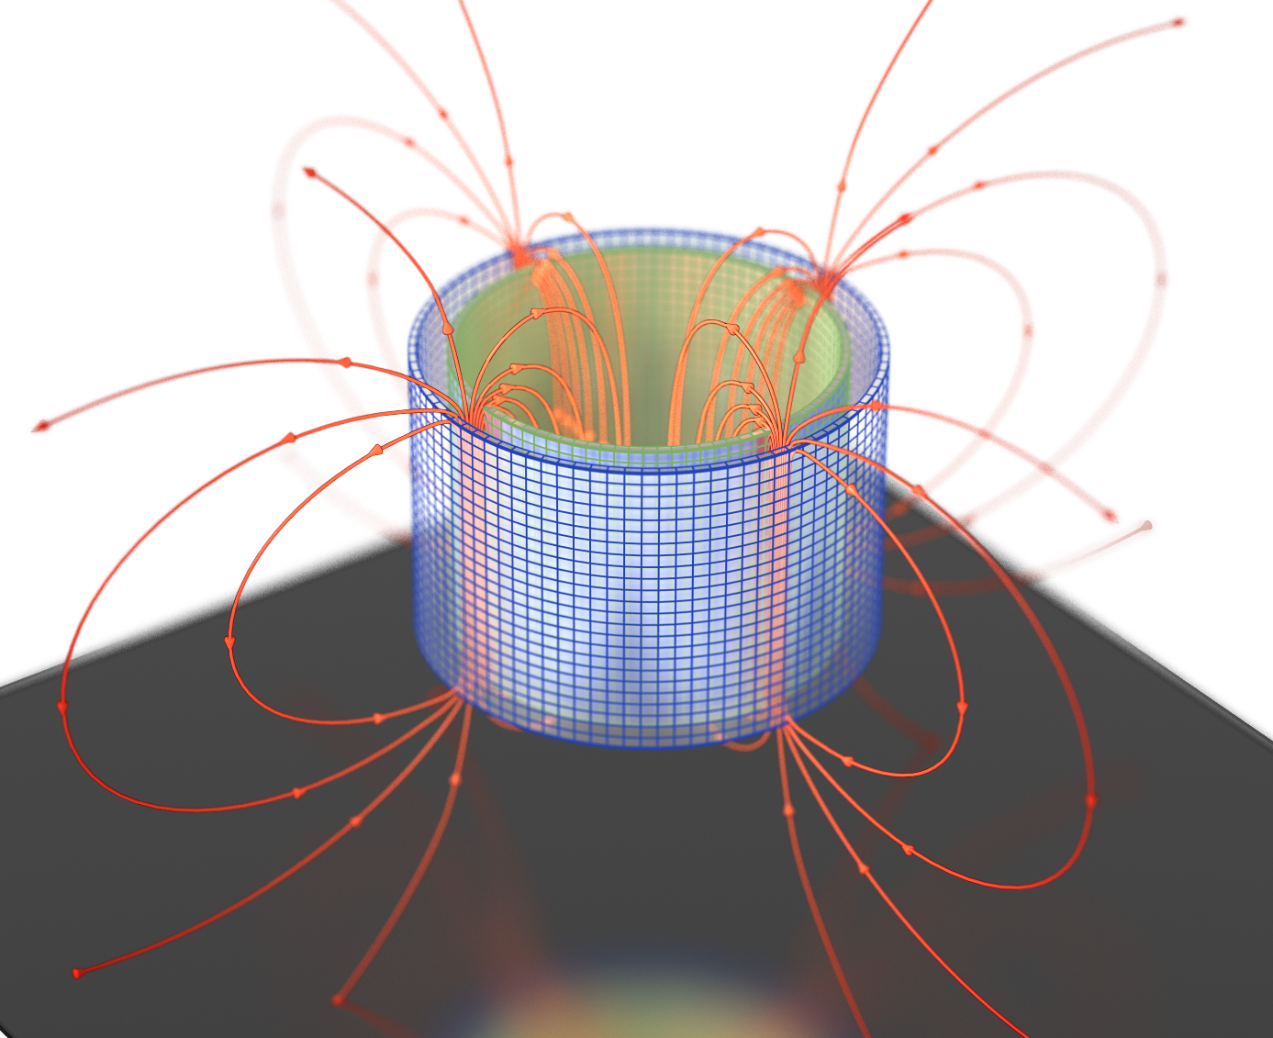
Double Layers: Flux quantization
Fix external magnetic field B_{z}
Trap current quanta, remove external B
Remaining Flux between layers is quantized:
Notes:
This diamagnetism is an interesting phenomenon, but it does not really define the character of a superfluid. The unique selling point of a superfluid is its macroscopic coherence. And in general, there are only two ways to detect whether a phase is really a superfluid phase. One way is by letting two ‘supposed’ condensates interfere. The other way is to look for some macroscopic quantization rule. Such macroscopic quantization shows quantummechanical principles at work in large-sized objects, and proves the existence of long-range order throughout the superfluid.
In superconductors, the “intereference of two superfluids” is seen in Josephson junctions. The quantization condition leads to the known fact that the magnetic flux passing through superconducting rings must be quantized.
So where does quantization come from? In superfluids, the current is proportional to the gradient of the complex phase. When we integrate along any closed contour inside the superfluid, the phase can pick up integer multiples of $2 \pi$. Therefore a circular current (around that contour) must be quantized.
We already saw that a electric or dipolar supercurrent is induced by an external magnetic field, and that these supercurrents in turn induce a magnetic field themselves. As a consequence, the magnetic field generated by a circular supercurrent must be quantized. This must also be the case for exciton supercurrents!
Our proposal to see this magnetic flux in double layer exciton superfluids is the following. Make a cylindrical device where the electron and hole layers are concentric, as shown on this figure. Above the critical temperature, you apply a magnetic field along the axial direction. Then you cool the sample down to its superfluid phase. This induces some number of current quanta to be included around the cylinder. If you then remove the external field, a flux remains going in between the layers as shown on this figure. The trapped flux in between the layers must be quantized in h over e (which is the fundamental flux quantum) times the magnetic susceptibility times the number of current quanta, n.
This is the first proposal to directly probe the possible macroscopic coherence of a supposed exciton condensate.
Time: 2:32 minutes
Formulas:
.\\. \oint \vec{\nabla} \phi \cdot \vec{dl} = 2 \pi n \\.\\

Slide 8
Conclusions
Electric dipoles → SU(2) ‘real’ fields
Exciton double layer superfluids → Fixed dipole direction and 2D. Exhibit:
Diamagnetism
Magnetic Flux Quantization
Notes:
And with that, I want to bring my talk to an end.
From a theoretical perspective, a we obtained a SU(2) structure due to the dipolar moment of the excitons. However, the SU(2) fields now correspond to the real magnetic fields.
For a double layer system we fixed the dipole direction, we made the system two-dimensional and formulated the Ginzburg-Landau free energy. We found two physical results. The system acts as a diamagnet and we proposed a way to unambiguously test the macroscopic coherence that is inherent to any superfluid phase.

Slide 9
Questions? And come to our workshop in Leiden, this April 26-29
Notes:
Finally, I also want to invite you to our workshop in Leiden, with talks about double exciton systems by Andy Millis from Columbia University and Peter Littlewood from Cambridge University.
I thank you for your attention and If you have any questions, I will be happy to answer them!
Time: 50 seconds

