Slide 1
Self-generated electron glasses in frustrated organic crystals
Louk Rademaker
(Kavli Institute for Theoretical Physics, Santa Barbara)
Leiden University, 4 December 2014

Slide 2
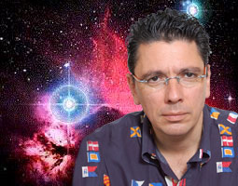
In collaboration with:
Vladimir Dobrosavljevic (FSU)
Samiyeh Mahmoudian (FSU)
Simone Fratini (Institut Neel, FR)
Arnaud Ralko (Institut Neel, FR)

Slide 3
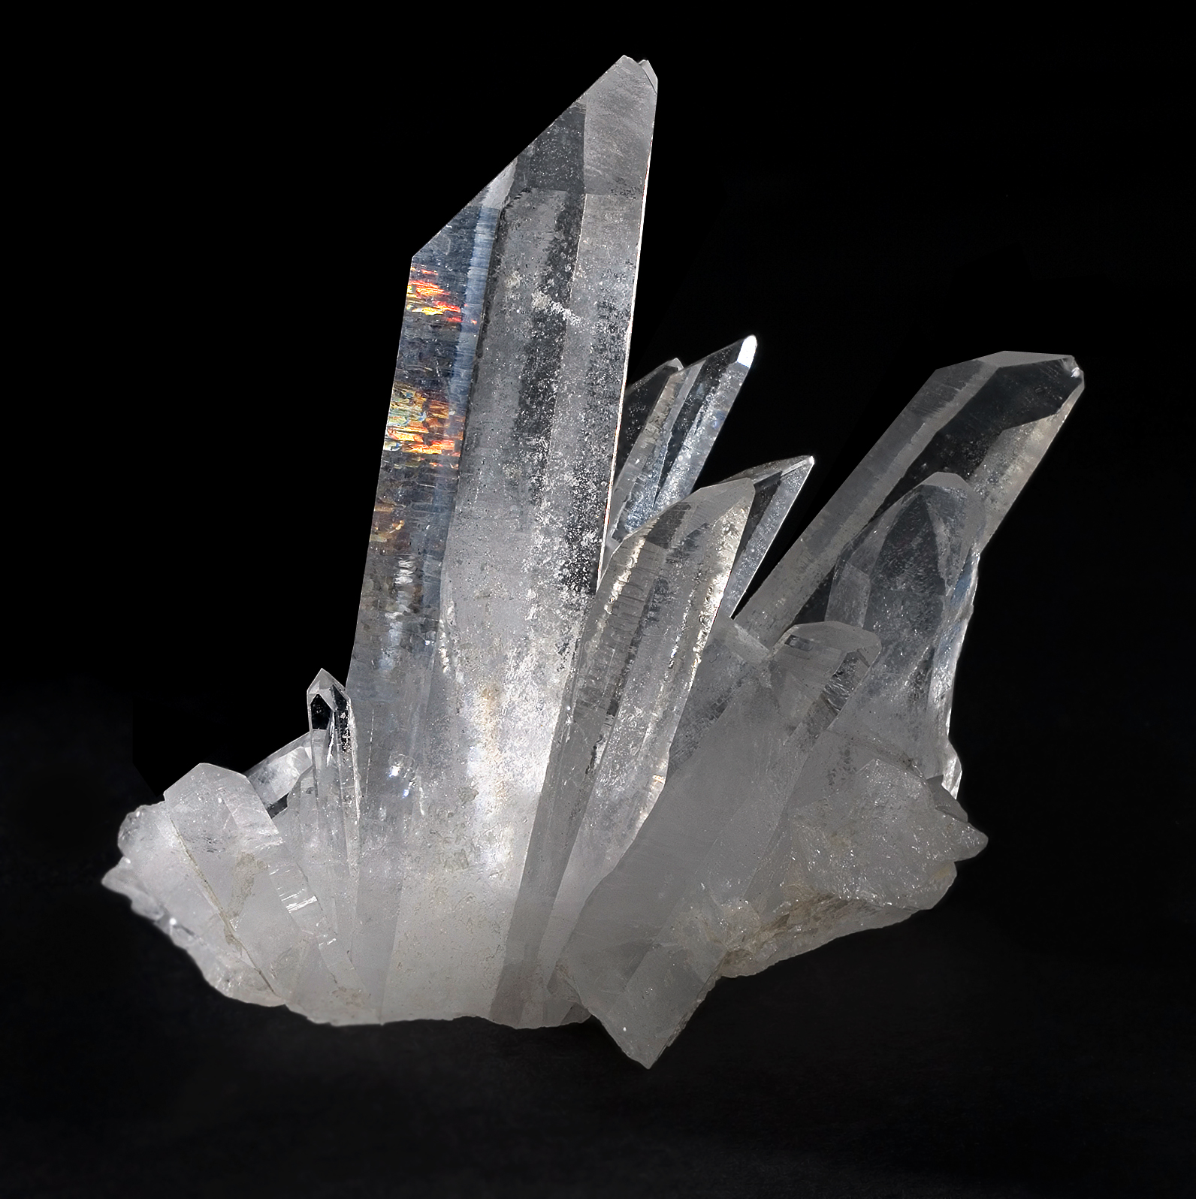
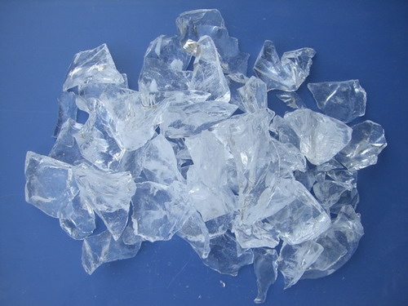
Solid States
Crystals…
Crystalline SiO₂
T_{m} ~ 2000 K
Supercooled liquid SiO₂
T_{g} ~ 1400 K

Slide 4
Supercooling a liquid

Slide 5
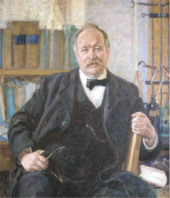
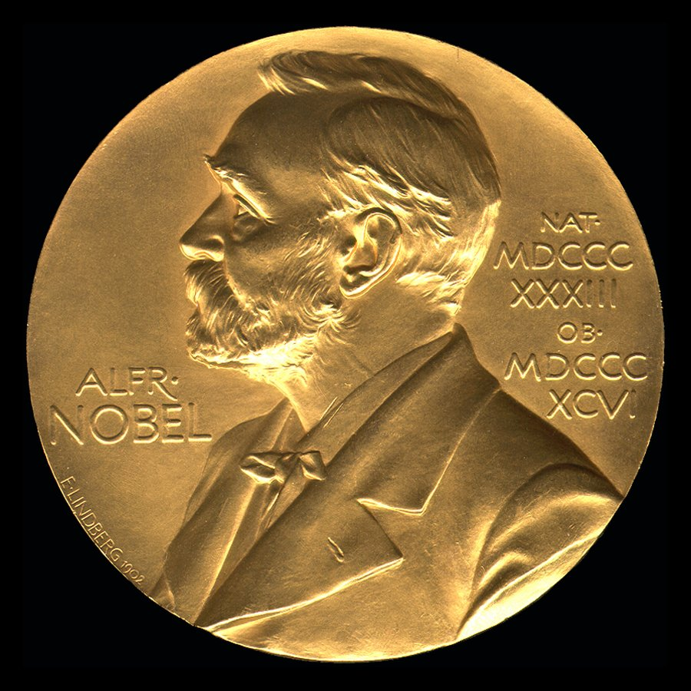
Supercool properties
Loss of ergodicity at glass transition
Typical dynamical timescale for probing the phase-space is given by Arrhenius Law:
Slow dynamics governed by transitions from one metastable state to another, barrier Δ
1903

Slide 6
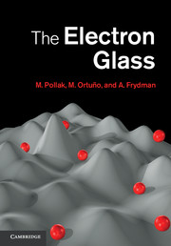
Electronic States
Gas: free Fermi gas
Liquid: Landau Fermi liquid
Solid: Wigner crystal, or charge-density-wave
Electron glass: Disorder!
- Anderson Localization
- Many Body Localization

Slide 7
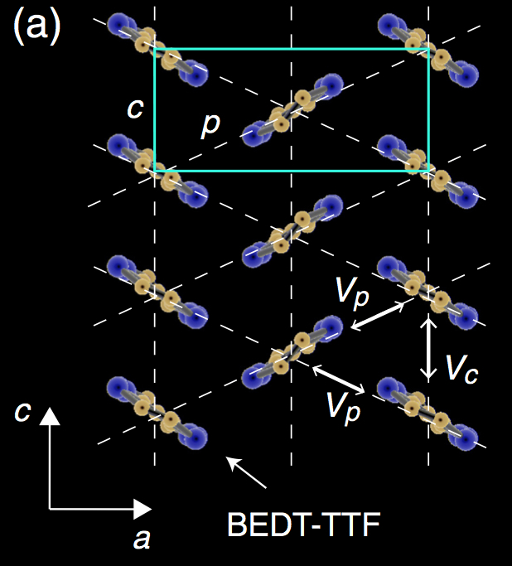
Disorder-free electron glass?
Ref: Kagawa et al., Nat. Phys. 9, 413 (2013)
(and Sato et al, JPSJ 2014; Sato et al, PRB 2014)
Material: Clean θ-(BEDT-TTF)₂RbZn(SCN)₄

Slide 8
Resistivity data
Electron solid:
Stripe order
Supercool
electron liquid!

Slide 9
Dynamical timescale
Equilibration experiments
Arrhenius Law!
Noise spectroscopy

Slide 10
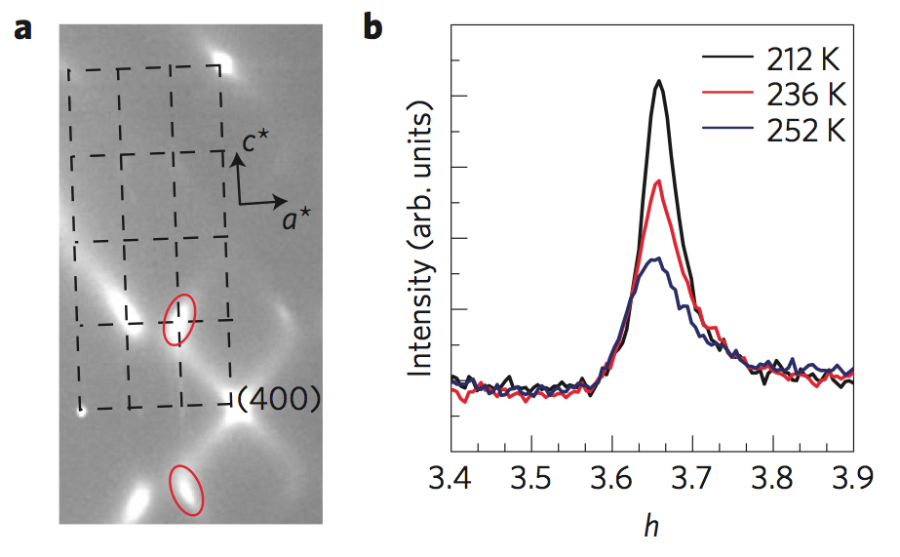
Local Charge clusters
X-ray studies of electronic order
‘Local’ order: not long-range
Conclusion: “Charge-cluster glass”

Slide 11
Let’s do theory
Starting point is spinless interacting electrons
Program:
Classical ground state (Variational Monte Carlo)
Quantum ground state (Exact Diagonalization)
Slow glassy dynamics (Metropolis Monte Carlo)

Slide 12
Short-range interactions
Degeneracy of ground states
(residual entropy!)
Zigzag Stripes
Straight Stripes
Three sublattice structure

Slide 13
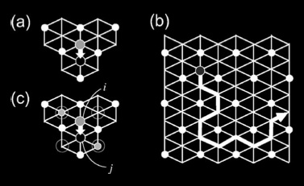
Pinball liquid
Taking quantum effects into account
Non-Fermi liquid with coexistence of localized and itinerant electrons
Ref: Merino, Ralko, Fratini, PRL 2013
Hotta & Furukawa, PRB 2006

Slide 14
Long-range interactions
Pinball liquid is not θ-RbZn ground state
Battle the frustration by more frustration:
Known to cause self-generated glassiness and to stabilize stripe order
Ref: Schmalian & Wolynes, PRL 2001; Rademaker et al, PRE 2013

Slide 15
Long-range interactions
Linear stripes are lowest in energy:
Energy differences extremely small
Yet: linear stripes are robust!

Slide 16
Exact diagonalization

Slide 17
Finite Temperature Monte Carlo
Metropolis: accept local move with probability
Infinite range interactions on finite lattice?Ewald summation:

Slide 18
Stripe charge order
Spinodal temperature T_{s} = 0.04V
Below T_{s} local update MC becomes non-ergodic

Slide 19
Relaxation Time
Autocorrelation function
If system equilibrates
Exponential tail of C(t) gives relaxation time

Slide 20
Relaxation Time
Arrhenius law, Δ = 0.2V

Slide 21
Aging & Memory
Below T_{s} aging scaling

Slide 22
Density Correlations

Slide 23
Conclusion
θ-RbZn is a self-generated glass (no disorder)
Due to frustration between long-range interaction and triangular lattice
Effective classical model explains:
Arrhenius relaxation behavior
Local charge clusters

