Slide 1
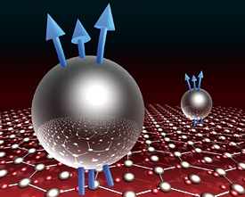
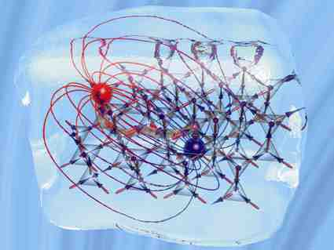
Café KITP
Quasiparticles
The Dreams That Stuff Is Made Of
Louk Rademaker

Slide 2
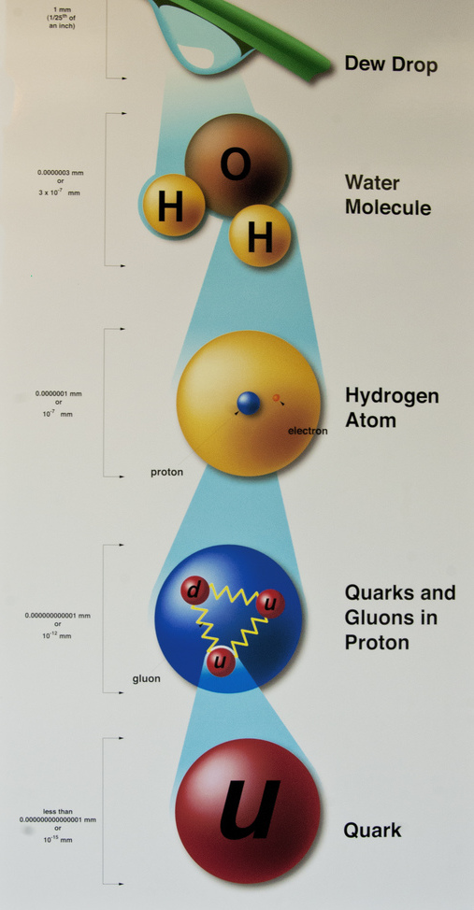
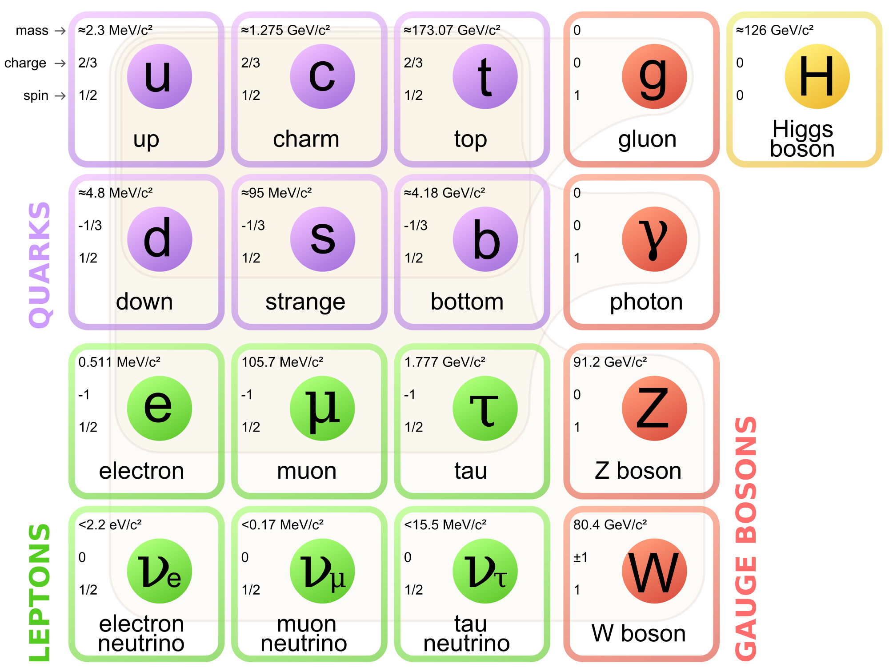
Reductionism
?
All matter consists of tiny indivisible ‘atoms’:
‘fundamental’ particles
“Standard”
Model
Notes:
Deep in our heart, we all understand the world in a ‘reductionist’ manner. That means that we think all matter we know of, in the end, consists of tiny indivisible particles. The Greek philosopher Democritus called those particles ‘atoms’, which is Greek for ‘indivisible’.
So for example: take a dew drop, if we look very close we can see it consists of water molecules, and those molecules consist of what we call atoms, and inside those atoms there is a nucleus and electrons around it, and inside the nucleus there are protons and neutrons, and inside them are quarks and gluons. We have finally arrived at what we call ‘fundamental particles’ – the building blocks of all matter as we know it.
Particle physicists find this collection of particles: we now know six quarks, six leptons, four ‘force’ particles and the Higgs boson; so fundamental that the theory that describes them is called ‘The Standard Model’
----
Quote from Democritus: “Nothing exists except atoms and empty space, everything else is opinion.”

Slide 3
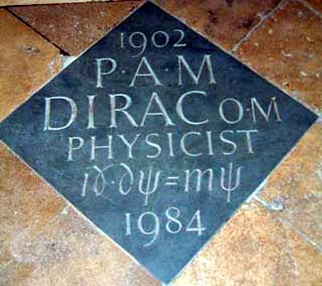
Dirac & The Electron
Energy
Electron!
Energy Levels
There is no lowest energy: electron can always gain
energy by moving downward!
Solution:
Vacuum is an infinitely deep ‘Dirac Sea’ of ‘bare’ electrons with negative energy!
Notes:
How do these fundamental particles work? About 80 years ago Paul Dirac was developing quantum theory to describe the electron, the simplest of all these fundamental particles.

Slide 4
Dirac & The Electron
Energy
Extra electron
Dirac Sea level
Pauli Exclusion Principle makes that extra electron
has bounded energy
Solution:
Vacuum is an infinitely deep ‘Dirac Sea’ of ‘bare’ electrons with negative energy!
A ‘particle’ is a ripple on the surface of the Dirac Sea
Notes:
How do these fundamental particles work? About 80 years ago Paul Dirac was developing quantum theory to describe the electron, the simplest of all these fundamental particles.

Slide 5
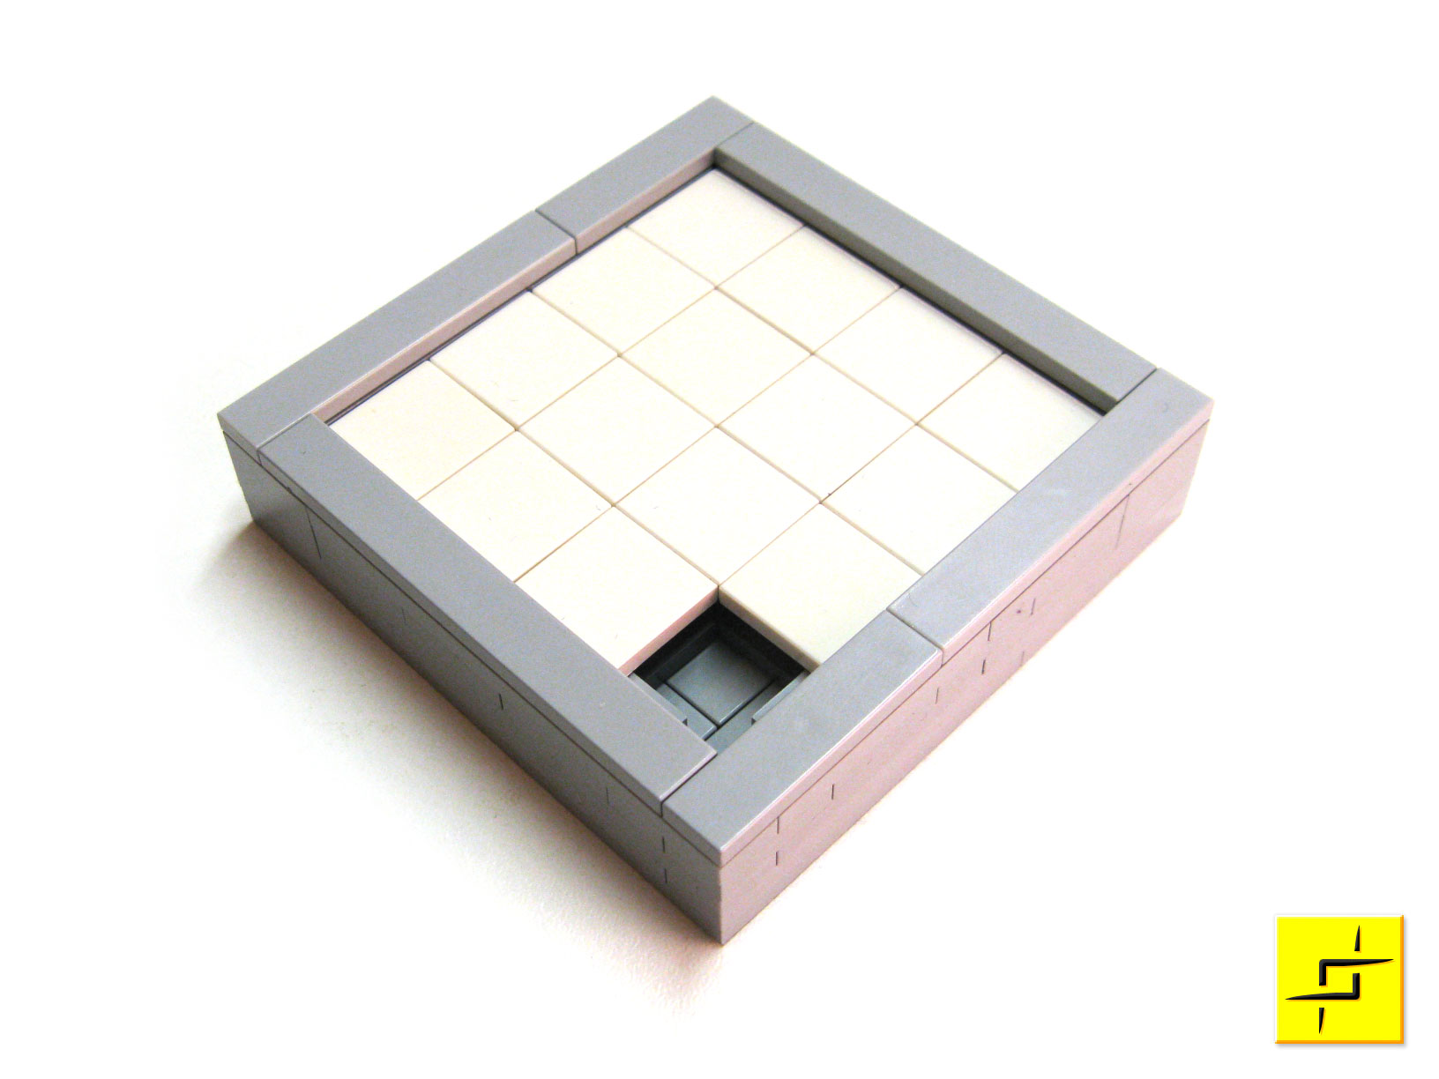
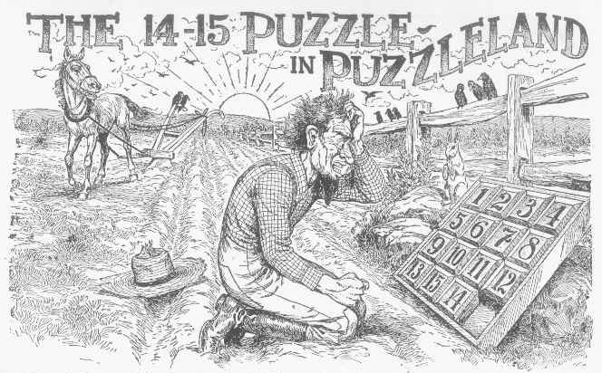
Not-so-fundamental particle
Remove one electron from the Dirac Sea, and you have created a 15-puzzle: the positron
So Dirac predicted the existence of antimatter
Remove electron

Slide 6
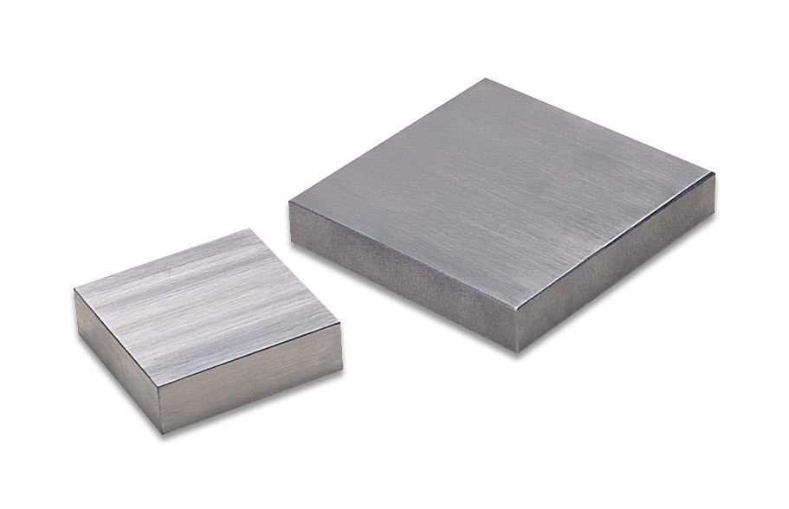
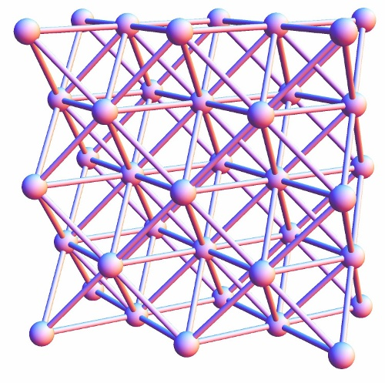
Solid State
Idea of a Dirac Sea is crazy, but it applies quite literally to a solid!
Number of electrons in an ounce of iron:
10,000,000,000,000,000,000,000,000
All electronics happens at the Fermi Sea level
Notes:
(Describe how solids work: many atoms together in a regular array)
Playground for new particles!!
Fermi Sea

Slide 7
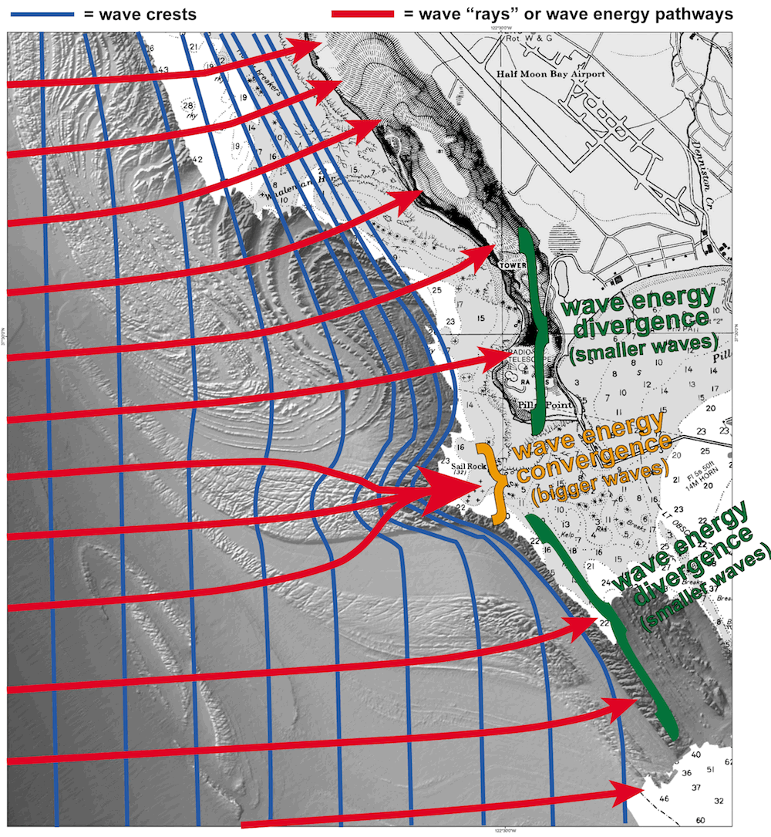
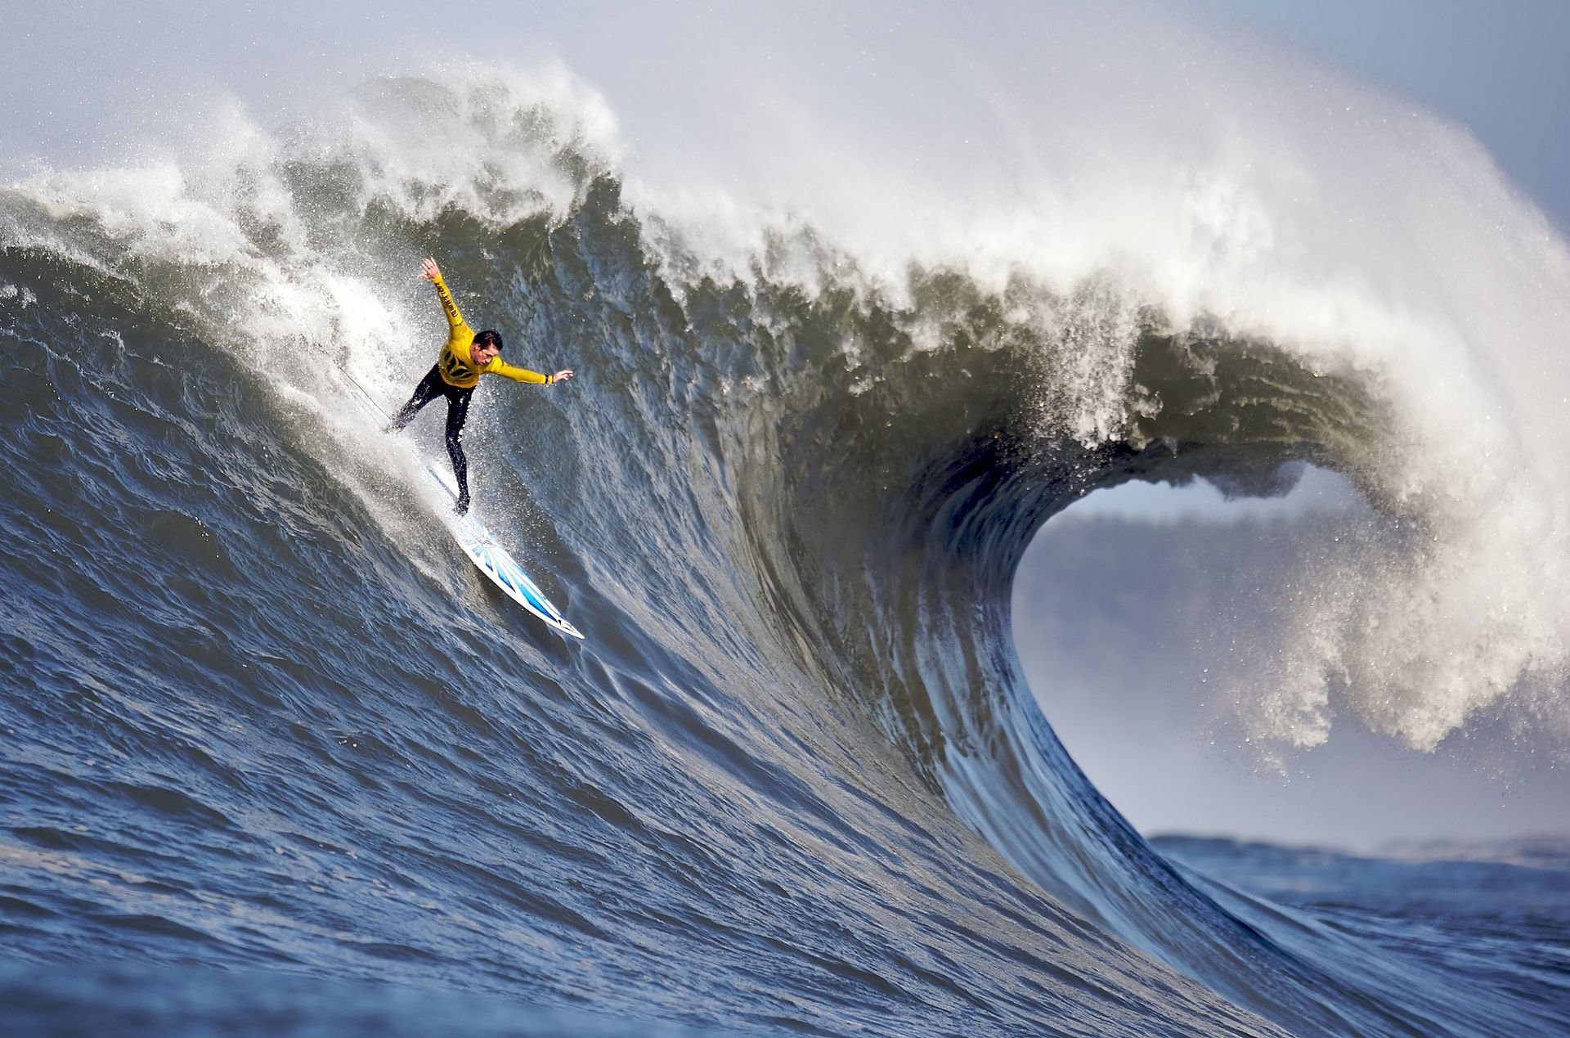
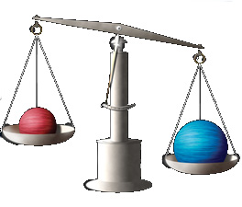
Quasiparticles
Different ‘Sea’ gives different ‘waves’ (particles)
Let’s engineer ‘vacua’ and ‘particles’ with special properties!
Different mass & different charge
Mavericks
Malibu
Huge waves
Small waves

Slide 8
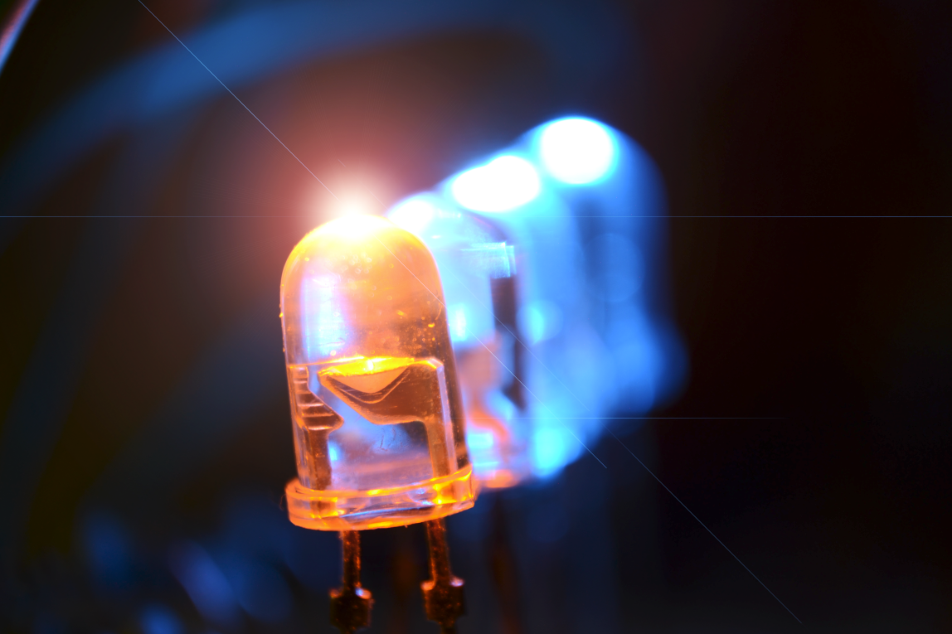
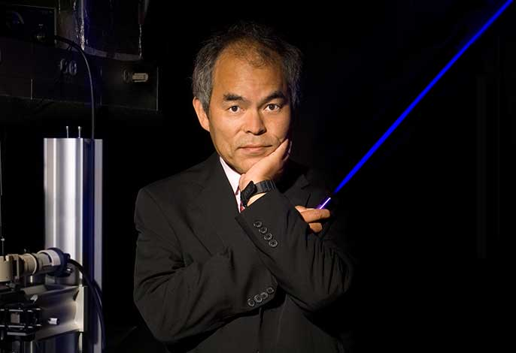
Different charge
Remember the positron?
Electronic engineers call it ‘a hole’: opposite charge to electron
Application: Light Emitting Diode
Diode = combination of a material with electrons and a material with holes

Slide 9
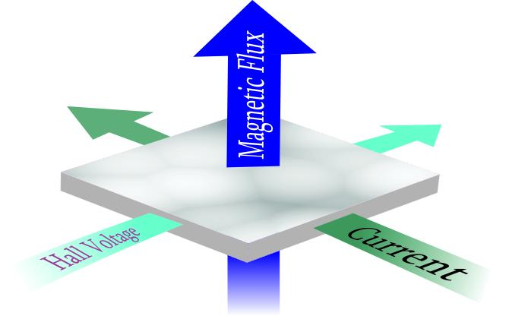
Split electrons
Can get much weirder: take a thin electronic slice in a magnetic field
Quasiparticle charge is 1/3 of electron charge!
Blow to reductionism?
Notes:
Can never split the electron with LHC?
No, but you can with 25 dollar tabletop exp

Slide 10
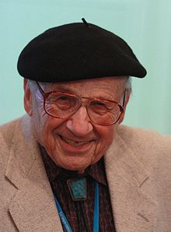
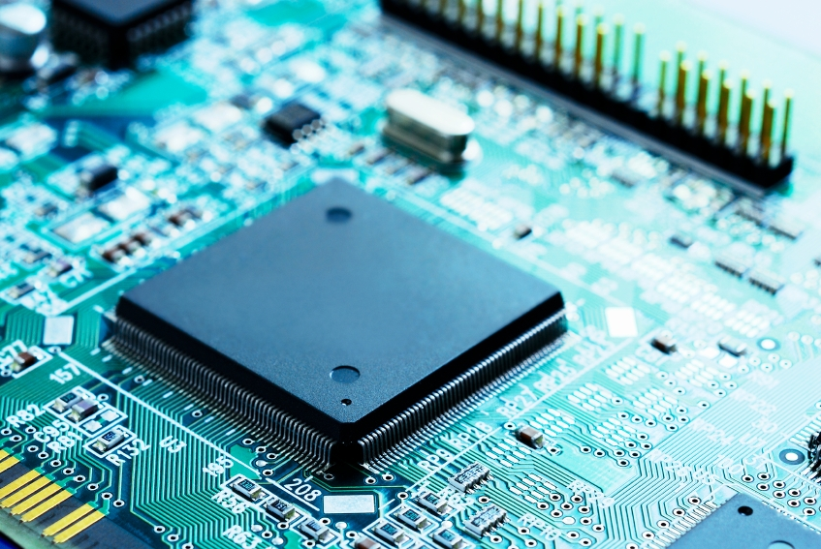
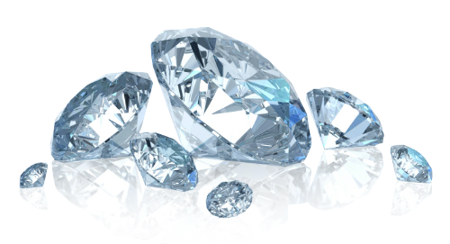
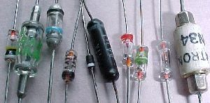
Different mass
Very important in electronic technology: engineering the mass and velocity of ‘quasiparticles’ in solids

Slide 11
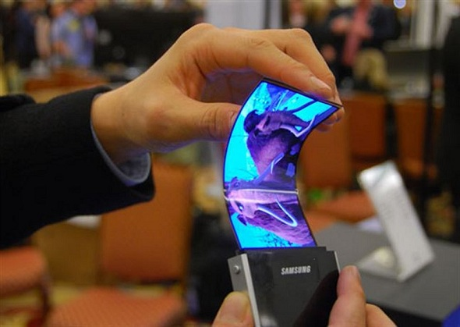
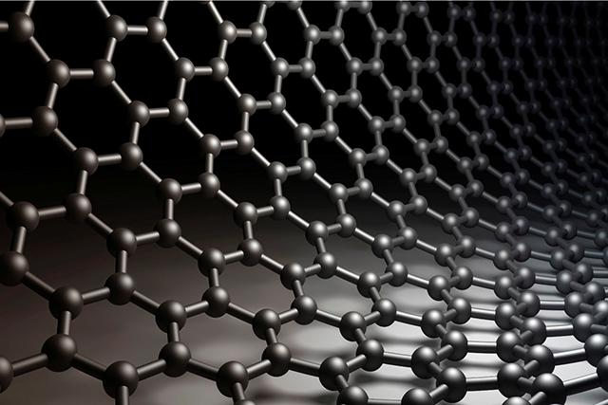
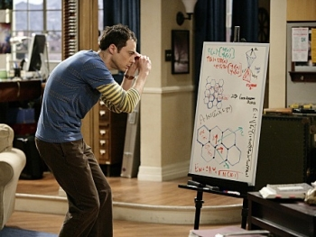
Particles without mass
Future tech: massless electrons in graphene
Emergence of “special relativity” (new maximum speed of light, etc.)

Slide 12
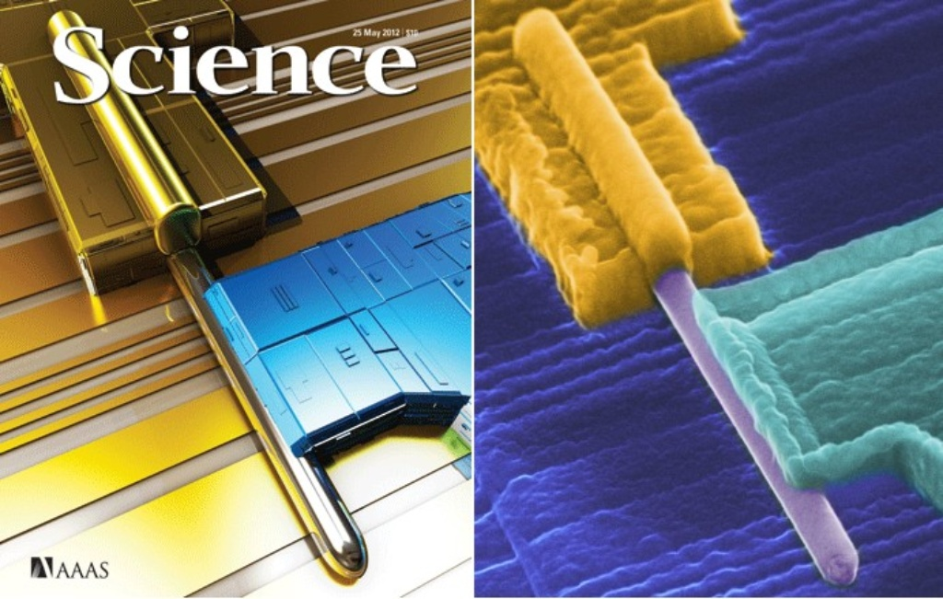
The Majorana Particle
Let’s go crazy: how about a quasiparticle that is equal to its own anti-particle?
Adding a particle to the Sea is now the same as removing a particle
Electron
Majorana!

Slide 13
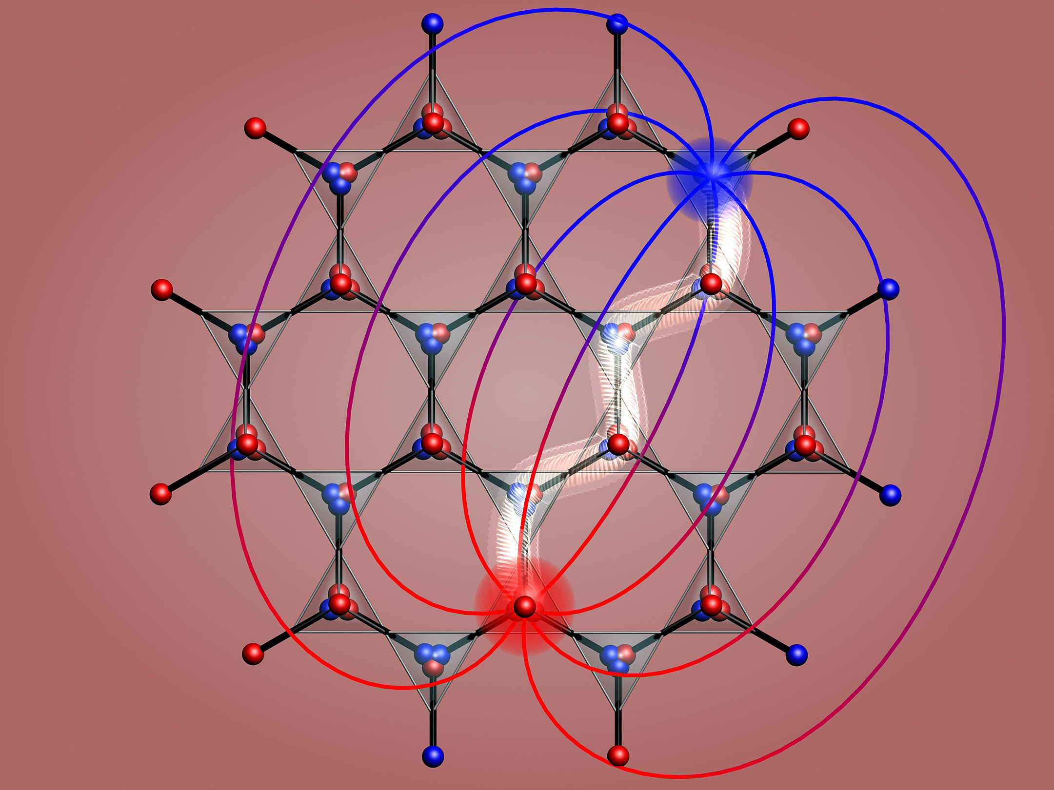
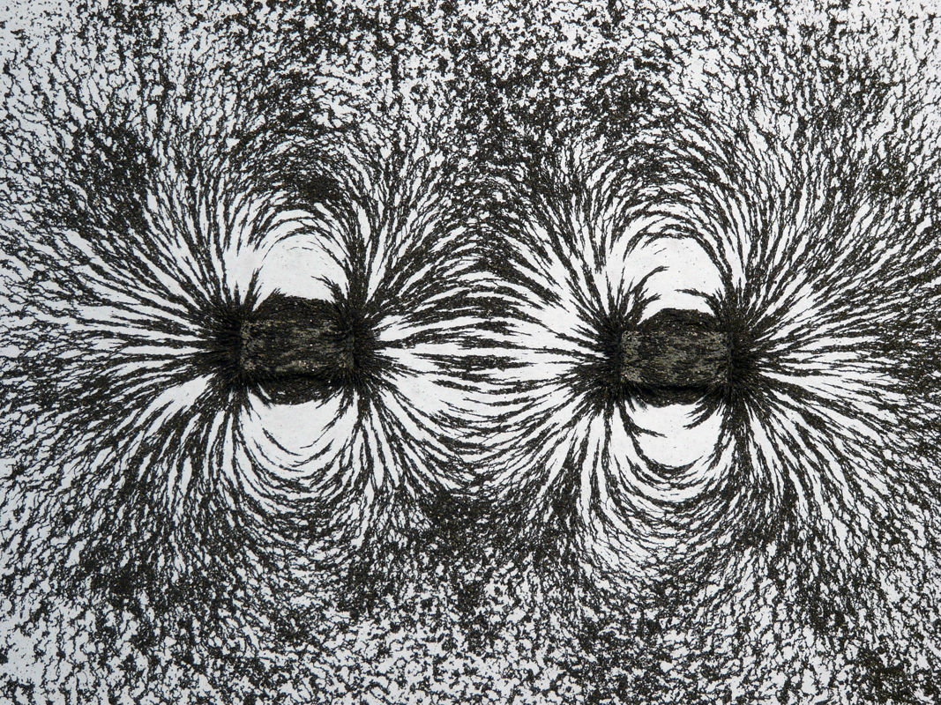
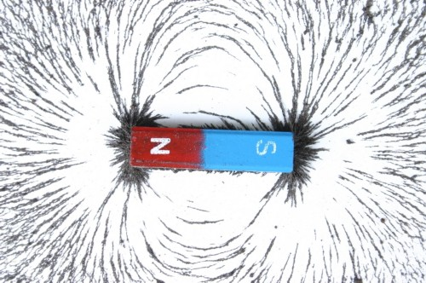
Magnetic charge?
There is no fundamental particle with a magnetic charge (they are all dipoles)
In a solid you can make it: spin “ice”
Notes:
By now, particle physicists have left the room screaming in agony. Nothing is sacred when making your own particles!

Slide 14
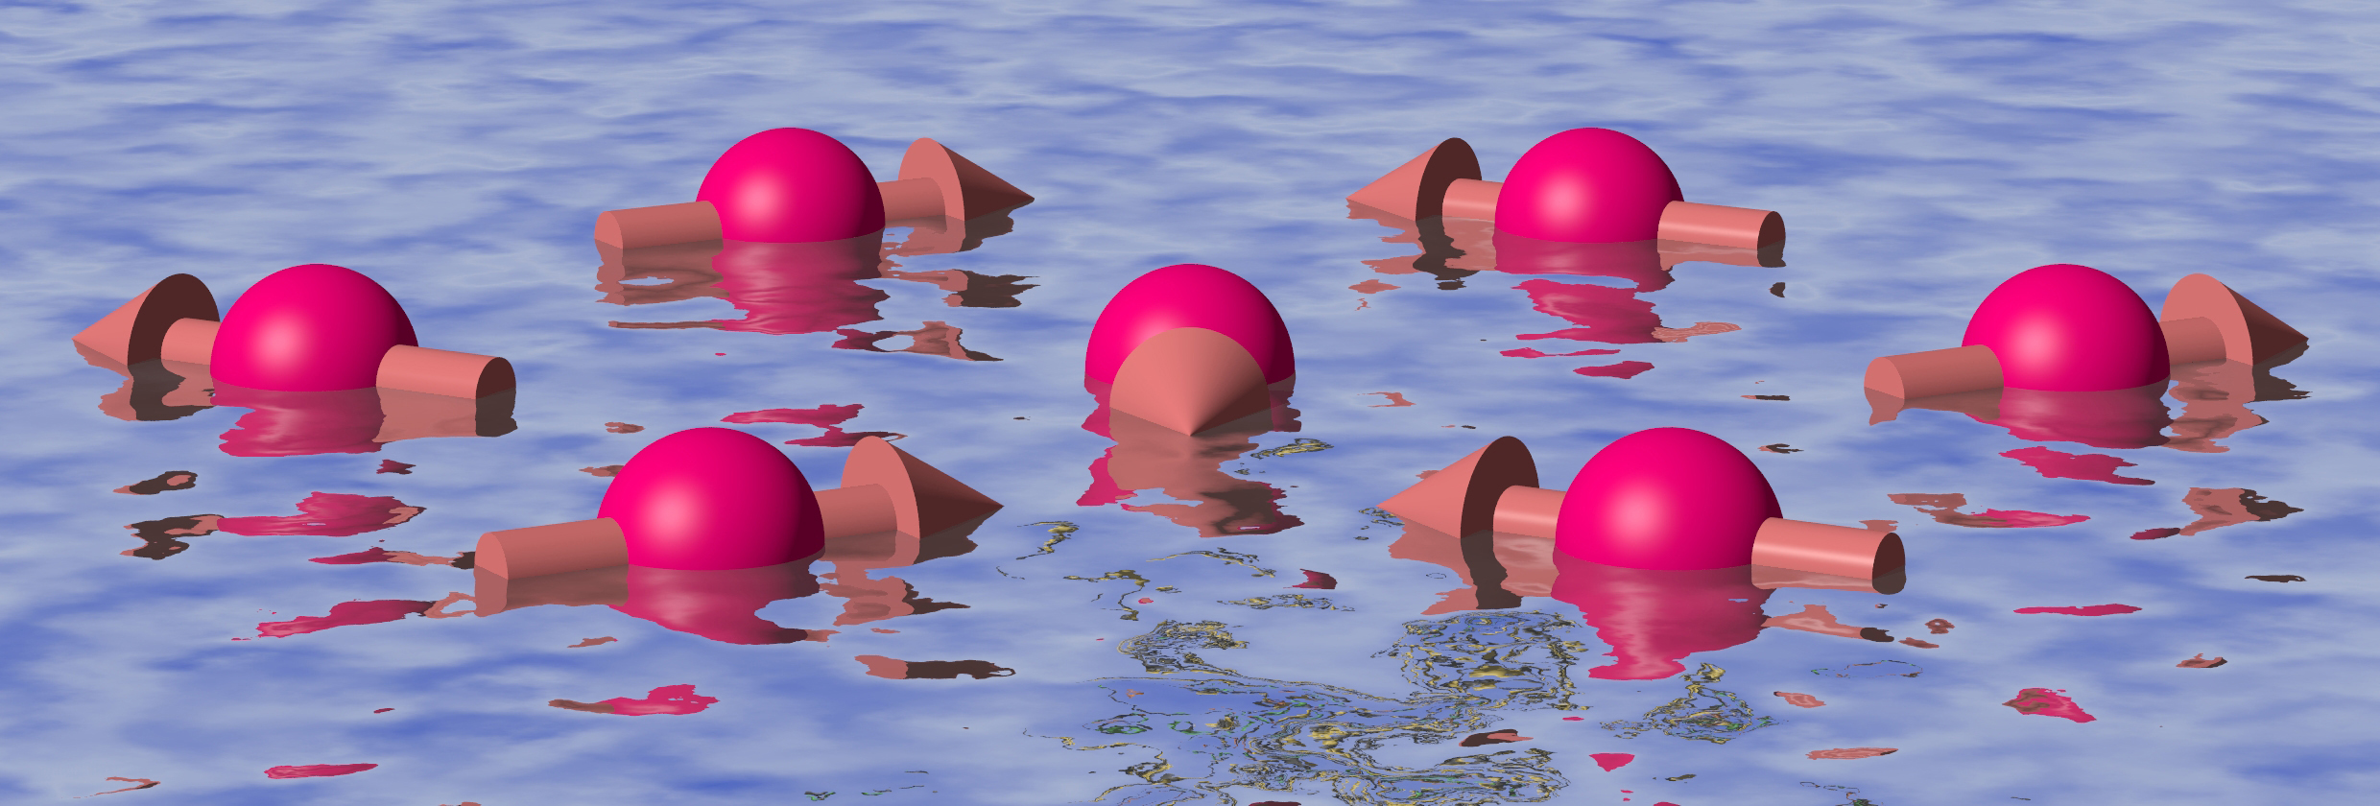
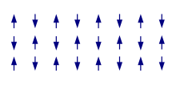
More crazy-ons with spins
Electrons are like little bar magnets: ‘spin’
Higgs boson? Already discovered in antiferromagnets
Photons (light particles)? Can make that in spin “liquids”

Slide 15
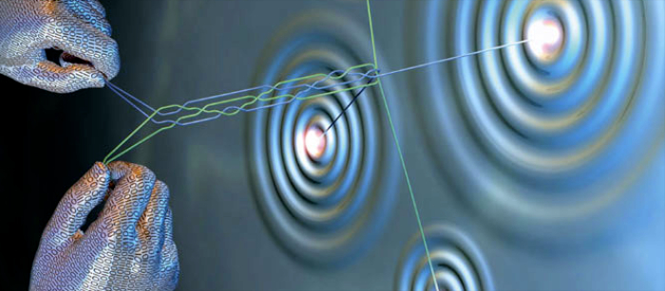
More crazy-ons: Anyons
Particles that leave an invisible trail, that can be braided to build future computers

Slide 16
Reductionism vs. Emergence
What are ‘fundamental’ and ‘quasi’-particles?
What makes more sense: break up stuff to understand the whole or combine stuff to create new physics?
If it walks like a duck, and quacks like a duck…

Slide 17
The Dreams that Stuff is Made Of
Engineering quasiparticles is the essence of electronic technology
Massless electrons, anyons, Majoranas, magnetic monopoles and so on will likely give us technology of the future
It’s not just weird dreams…
Quasiparticles are Dreams that Stuff is Made Of

