Slide 1
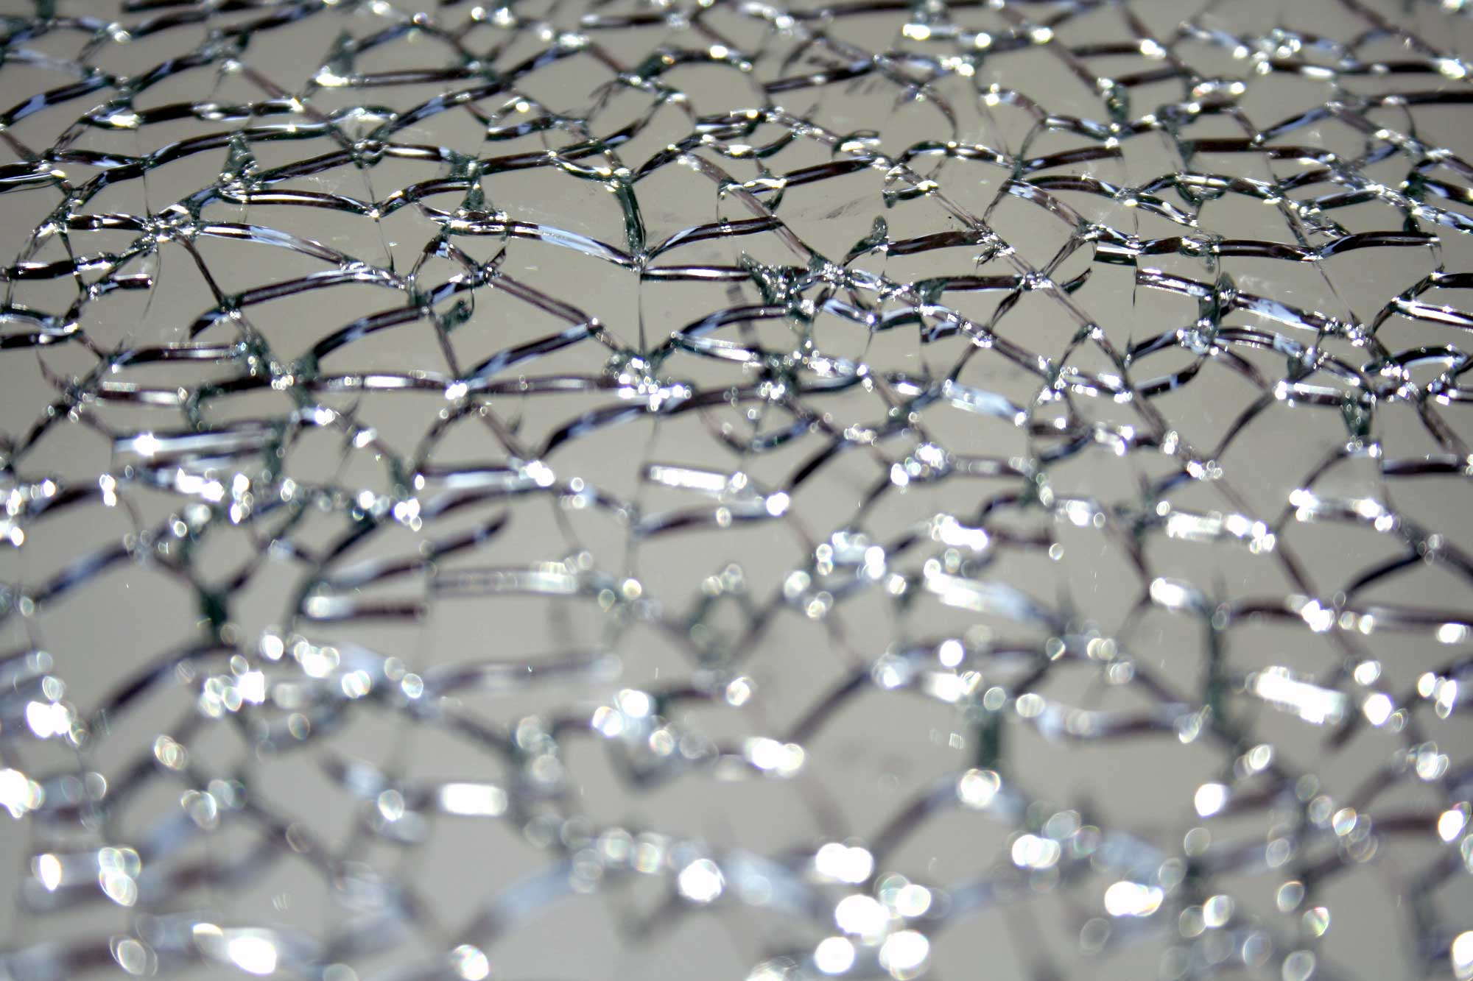
MBL-to-Ergodic Transition from the perspective of
Integrals of Motion
Louk Rademaker (KITP Santa Barbara), Miguel Ortuño, Andres Somoza
Transport in Interacting Disordered Systems, Granada
Tuesday 23 August 2016

Slide 2
OVERVIEW
Realism: Disorder + Interactions
Ergodicity vs. Integrals of Motion
Anderson Insulator to Many-Body Localization
Displacement Transformations
Localization of Integrals of Motion
Interactions between IOMs
What Happens At the Transition?
Notes:
Why are we interested in the phenomenon known as many-body localization?
There is the simple answer that any realistic, actually existing material has both a certain degree of disorder as well as nonzero interactions between the electrons. The realist in ourselves requires us to study electron transport in the presence of disorder ́and interactions, instead of the more pathological examples of the free Fermi gas, the disorder-free Landau Fermi liquid or the noninteracting Anderson insulator.
Such level of realism usually just means hard work. However, I find it only worth doing this hard work when conceptually new ideas arise. In the context of disorder plus interactions this new idea is the question of whether and when statistical mechanics itself is valid.
In this presentation I will first introduce the concept of ergodicity for quantum systems, and show how it is related to the integrals of motion.
The Anderson Insulator and the interacting Many-Body Localized phase are a special case of non-ergodic systems, because of local integrals of motion. I will show our method of how to compute it, and show you results.

Slide 3
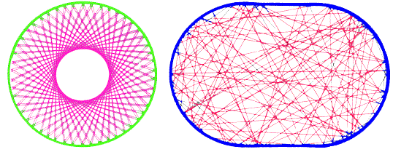
Classical Ergodicity
Stat-Mech: Long-time average = Ensemble average
Only true if ALL of phase space is covered: ERGODICITY
NON-ERGODIC
ERGODIC
Existence of INTEGRALS OF MOTION (IOM)
Notes:
Stat-mech, as you know it, tells us that the properties of a (very) large system in equilibrium can be described by only a few macroscopic parameters such as temperature, chemical potential, and so forth. This is true only if the microscopic dynamics of our large system lead to a static configuration described by a thermodynamic ensemble.
In classical physics, this is indeed the case, generically. This is known as the ergodic theorem: in the space of all configurations with the same energy, the system will have visited any part of this phase space if you wait long enough. It can be visualized by ‘billiard problems’, where in an ergodic billiard a particle reflected at the sides will, at some point, have visited all of the billiard.
The notable exceptions (such as Fermi-Pasta-Ulam or this spherical billiard) are systems where, besides energy, there are other conserved quantities present. In this case, it’s the angle at which the particle is reflected. The existence of such an integral of motion leads to nonergodic behavior.

Slide 4
Quantum Ergodicity?
Integrability = Existence of macroscopic many IOMs
…but…
Every Projection onto an Eigenstate is an IOM!
Quantum Systems Cannot Be Ergodic?
Notes:
Can we extend this concept to quantum systems?
Yes, of course, and usually people refer to non-ergodic systems as being ‘integrable’ in that they posses macroscopically many integrals of motion.
But something is wrong with this picture. Every projection operator onto an eigenstate is an integral of motion. There are macroscopically many of those, in fact, exponentially many in the number of degrees of freedom!
Therefore, naively extending the concept of classical ergodicity to quantum systems suggests quantum systems cannot be ergodic. This is of course wrong!

Slide 5
Quantum Ergodicity!
ALL systems Locally thermalize towards Generalized Gibbs Ensemble
Relevant IOMs are Charge DENSITIES
Every conserved charge density leads to thermodynamic parameter
(electric charge, mass, energy, momentum, etc.)
Projection operator is NOT a Charge Density (in general)
Refs: Doyon arXiv:1512.03713; Essler&Fagotti arXiv:1603.06452
Notes:
Recently a much better notion of quantum ergodicity has been developed.
Take a typical initial state psi and a local operator, A, and look at it’s expectation value at very late times. Thermalization means that this tends, at infinite time, to an expectation value in Generalized Gibbs Ensemble.
A GGE is similar to the Gibbs ensemble, but instead of only the Hamiltonian you need to include all integrals of motion that can be written as the sum of local operators. In other words, they need to be charge densities. And like temperature for the Hamiltonian, now each charge density requires a thermodynamic parameter to classify the thermal state.
It has last year been proven that all short-range interacting translationally invariant quantum systems for most typical initial states will thermalize.
And it is important to note that a projection operator is in general not a charge density, so the problem with quantum ergodicity from the previous slide is no longer present.

Slide 6

ANDERSON INSULATOR
The exception to Thermalization is the
See book by Pollak, Ortuno and Frydman
HOPPING
QUENCHED DISORDER
ALL Single-Particle Wavefunctions
Exponentially Localized
1d & 2d
Hamiltonian is quadratic & diagonal
Really Local Integrals of Motion (LIOM)
Notes:
The Anderson Insulator is a notable exception to the story of thermalization. You all know the Anderson insulator: with hopping and Quenched disorder, and of course I needed to include a picture of Pollak’s book.
In 1 and 2-dimensions all single-particle wavefunctions are exponentially localized. The Hamiltonian is then quadratic and can trivially be diagonalized.
Now these occupation numbers are of course integrals of motion. And they are, because of these wavefunctions, truly local. These local integrals of motion imply that I can’t thermalize: the knowledge about the occupation of such a wavefunction will never spread over the system, so at any time local measurements remember the details of the initial configuration.
And this is a general statement: the existence of local integrals of motion prevents thermalization and prohibits the use of statistical mechanics.
--
Wave-functions
H=-t\sum_{\langle ij\rangle} (c^\dagger_i c_j + h.c.) + \sum_i \mu_i n_i
|\Psi(r)| \sim e^{-r/\xi}

Slide 7
Many-Body Localization
Anderson Insulator + WEAK Interactions does NOT Thermalize
LIOM PICTURE
ORIGINAL PICTURE
With interactions there still exist
LOCAL integrals of motion :
The HAMILTONIAN can be written as
Localization persists at low T in ALL orders in perturbation theory.
The Anderson LIOMs are stable with respect to interactions
SUPPORT
OF QLIOM
DISTANCE FROM CENTER
Serbyn+Papic+Abanin (2013), Huse+Nandkishore+Oganesyan (2014)
Basko+Aleiner+Altshuler (2006)
Notes:
And then it becomes easier to understand why in the presence of weak interactions the Anderson insulator remains stable.
The original work by ‘BAA’ showed that the localization persists up to all orders in perturbation theory. Another way of saying the same is using this language of integrals of motion. Even with weak interactions there still exists local integrals of motion. The Hamiltonian is no longer quadratic, but can still explicitly be written in terms of these integrals of motion by including classical interactions between them. Localized iom’s are quite robust!
H = \sum_\alpha \xi_\alpha n_\alpha+\frac{1}{2} \sum_{\alpha \beta \gamma \delta} V_{\alpha \beta \gamma \delta} c^\dagger_\alpha c^\dagger_\beta c_\gamma c_\delta
[H, \tau^z_i] = [\tau^z_i, \tau^z_j] = 0
H = \sum_i \xi_i \tau^z_i + \sum_{ij} V_{ij} \tau^z_i \tau^z_j + \ldots

Slide 8
SOME UNITARY
with
ANY Hamiltonian can be made into classical form
★ Ros+Müller+Scardicchio (2015)
★ Chandran+Kim+Vidal+Abanin (2015)
Notes:
In fact, any interacting Hamiltonian can be brought into this ‘classical form’. There exists a unitary transformation where the integrals of motion, here denoted as ‘tau-z’, are obtained after transforming the Anderson occupation numbers.
And there have been many works that compute these integrals of motion.
Perturbative approach; For Example these guys. I’m not even going to try to get into that, I assume you are familiar with this work.
Another noteworthy approach, conceptually nice but not very practical: Chandran and coworkers.
\tau^z_i = \lim_{T \rightarrow \infty} \frac{1}{T} \int_0^T dt \; n_i (t)

Slide 9
Resonances
QUANTUM Terms in Hamiltonian lead to RESONANCES
BUT IT CAN
DIVERGE
MANY Divergent Resonances can cause Perturbation Series to FAIL
Notes:
Now the most difficult part of most perturbative approaches lays in so-called ‘resonances’. This interaction term ‘dresses’ single-particle operators, in a way that can be diagrammatically portrayed with a vertex. In second-order perturbation theory you get this correction, and the problem is that the denominator of this term can become zero. Then this whole term diverges, and this can cause the perturbations series to fail.
Nomenclature: only if the denominator of this perturbative term is close to zero, we talk about a resonance, because

Slide 10
Isolate Quantum Terms
IDEA: Deal with each resonance EXACTLY
Select an Individual Quantum Term
such that the relevant part of the Hamiltonian reads
PROPERTIES:
★
Define ORDER as number of operators in Term
★
Order CANNOT DECREASE through products:
★
is CLASSICAL
Rademaker+Ortuño PRL 2016
Notes:
Our idea is isolate single interaction terms and then deal with them exactly to avoid resonance problems.
X = c^\dagger_\alpha c^\dagger_\beta c_\gamma c_\delta
H' = \sum_\alpha \xi_\alpha n_\alpha
+ \frac{1}{2} V_{\alpha \beta \gamma \delta} \left (X^\dagger + X\right)
X^\dagger X X^\dagger = X^\dagger

Slide 11
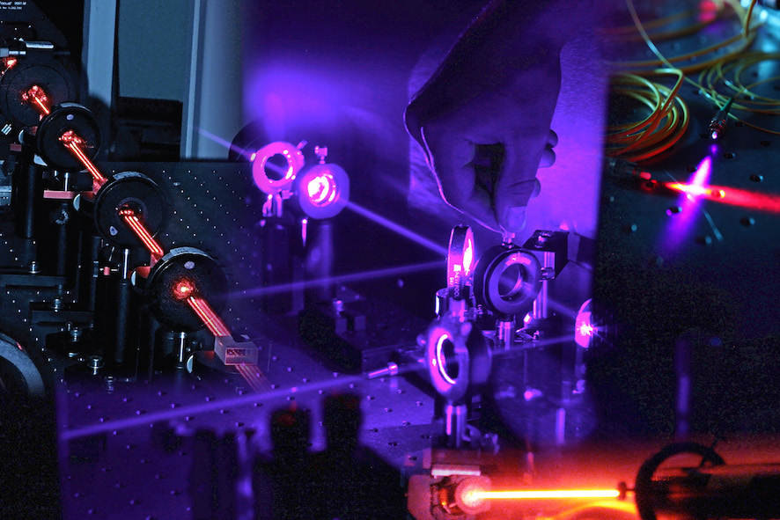
Displacement Transformation
Inspired by Quantum Optics, define the
Displacement Operator
Using properties of Quantum Terms, we can expand Exactly
With the Hamiltonian introduced before
Is Completely Classical
All New Terms are
of Higher Order
★
★
And the Right Choice of the Parameter λ
★
★
Notes:
\tan 2 \lambda = - \frac{V_{\alpha \beta \gamma \delta}}{ \xi_\alpha + \xi_\beta - \xi_\gamma - \xi_\delta}

Slide 12
Subsequent Transformations
The FULL Unitary Transformation is then a product
SYSTEMATICALLY make the Hamiltonian Classical
★ Transform 4th Order Quantum Term with Largest Coupling
★ Repeat process – Largest Coupling Decreases EXPONENTIALLY
★ After iterations 4th Order Part is Classical
★ REPEAT This Process for 6th Order, etc…
Notes:
H = \xi_\alpha n_\alpha + \frac{1}{2} V_{\alpha \beta \gamma \delta} c^\dagger_\alpha c^\dagger_\beta c_\gamma c_\delta

Slide 13
Numerical Results
Model:
Methods:
1. Direct implementation of Displacement Transformations
2. Exact Diagonalization of Few-Particle States
Similar to XXZ chain with Random Fields
Large W gives MBL Phase, Small W Delocalized Phase
Notes:
It’s now time to show you some results. Our model is the spinless Anderson model in one dimension plus nearest neighbor repulsion. This is the same as the XXZ model with random fields. For small disorder there should be a delocalized phase, and for large disorder there is a nonergodic MBL phase.
On a practical note, the following results are obtained with two complementary methods. We either implemented the displacement transformations exactly, or we used the exact diagonalization of few-particle states to obtain
|\psi(t) \rangle = e^{-iHt} | \psi (0) \rangle
A(t) = \langle \psi(t) | \mathcal{A} | \psi (t) \rangle

Slide 14
Accuracy
Method works better at strong disorder
Terminating at higher ORDER gives better results
Notes:
On a practical note, we also need to terminate the displacement transformations. If we keep terms up to all orders we have diagonalized the system exactly! Instead, we can focus only on the direct interactions between integrals of motion. We compared at small system sizes the resulting ground state energy with ED, and we see that our method works better if the disorder is stronger. Furthermore, if we take the next order interactions, between three integrals of motion, into account, we improve the accuracy with an order of magnitude.
|\psi(t) \rangle = e^{-iHt} | \psi (0) \rangle
A(t) = \langle \psi(t) | \mathcal{A} | \psi (t) \rangle

Slide 15
Spread of Integrals of Motion
“Weight” as a function of r
Notes:
Now the first result itself is the spread of the integrals of motion themselves. Upon this transformation, they obtain this form by being ’dressed’ with fourth order terms. The parameter ’alpha’ here typically decays exponentially. Increasing disorder leads to a shorter localization length, as can be seen in this plot of the geometric mean of the integrals of motion, averaged over disorder realizations as a function of distance.
|\psi(t) \rangle = e^{-iHt} | \psi (0) \rangle
A(t) = \langle \psi(t) | \mathcal{A} | \psi (t) \rangle

Slide 16
Effective Hamiltonian
Exponential decay of J_{ij} parameters
Different localization length from IOMs
Notes:
We can also look at the effective classical Hamiltonian. Recall it has this shape. The interactions, J_ij, also decay exponentially with distance. Here you see the geometric mean of these J_ij as a function of distance. Remarkably, these interactions seem to decay with a different localization length than the spread of the integrals of motion, here shown in dashed lines.
This shows that in the MBL phase, there are actually two different many-body localization lengths.
|\psi(t) \rangle = e^{-iHt} | \psi (0) \rangle
A(t) = \langle \psi(t) | \mathcal{A} | \psi (t) \rangle

Slide 17
Entanglement Spread
Logarithmic spread of Entanglement
Factor 10 more disorder
Factor 10¹⁰ slower entanglement!
Notes:
The exponential decay of the interactions has been suggested to give rise to the extremely slow entangling dynamics of the MBL-phase.
The argument is simple. If the interactions are exponentially decaying, then two bits at a distance r take 1/J time to entangle. The bipartite entanglement entropy between two halves of the system, defined here, thus scales as the number of bits entangled at a certain time, which then grows logarithmically with time.
Indeed, even with our simple effective Hamiltonian we see extremely slow growth of the entanglement. It is also worth noting that when we increase the disorder about a factor 10, this leads to an entanglement spread that is 10 –to-the-10th power slower! (Look here at the time axis!) This is a clear indication of the slow dynamics in the MBL phase.
|\psi(t) \rangle = e^{-iHt} | \psi (0) \rangle
A(t) = \langle \psi(t) | \mathcal{A} | \psi (t) \rangle

Slide 18
Distribution of J_{ij} parameters
Typical distribution of J_{ij} approaches 1/J (white noise)
Notes:
Finally, I want to show you the distribution of these interaction parameters. Interestingly, they typically approach a 1/J distribution, as can be seen here in a log-log plot of the distribution of interaction parameters for different distances and fixed disorder strength. This distribution has a long ’tail’ so there are relatively many ’strong’ ’rare’ couplings. This is something we are still investigating, but this probably has an important consequence for the transition to ergodic behavior.
|\psi(t) \rangle = e^{-iHt} | \psi (0) \rangle
A(t) = \langle \psi(t) | \mathcal{A} | \psi (t) \rangle

Slide 19
MBL-to-Ergodic Transition?
At n=2 order no clear sign in typical results
Extremely long many-body localization length
Role of rare fluctuations?
Powerlaw decay of interactions?
Higher order, higher dimensions?
Notes:
Because indeed, so far we have not seen any clear indication of a transition in the typical results I showed, other than the factor 10^10 difference in entanglement times.
However, if instead of the typical value we look at average values, at low disorder, we see different behavior. The interaction parameters seem to follow a powerlaw decay rather than an exponential decay. This enormous difference between typical and average can only be a consequence of ’rare’ fluctuations, and is something which requires further study. This picture, that the ergodicity is driven by ’rare’ events, is consistent with recent numerical works that have seen subdiffusive behavior and other anomalous dynamics close to the supposed transition.
Our aim is to study this in higher order, and also higher dimensions.
|\psi(t) \rangle = e^{-iHt} | \psi (0) \rangle
A(t) = \langle \psi(t) | \mathcal{A} | \psi (t) \rangle

Slide 20


IN COLLABORATION WITH
Miguel Ortuno (Murcia, Spain)
Andres Somoza Gimeno (Murcia, Spain)

Slide 21
CONCLUSIONS
MBL-to-Ergodic Transition with Integrals of Motion
★ Truly Local Integrals of Motion prevent Thermalization
★ New Method of Displacement Transformations to compute IOMs
★ Typical Properties of IOMs always Localized
★ Rare Properties can be responsible for Ergodic behavior?
★ Other applications: improve Hartree-Fock, disorderfree systems
Reference: Rademaker, Ortuño PRL 116, 010404 (2016)

