Slide 1
Quenching the Kitaev model
Louk Rademaker (Perimeter Institute)
Toronto University, 18 October 2017

Slide 2
Overview
Introduction:
  Why quench a spin liquid?
Methods:
  The Kitaev Honeycomb model
  Writing the Néel state in Z₂ gauge field representation
Results:
  Return amplitude
  Prethermalization plateau
  Static correlations
  Final steady state
  Dynamic correlations

Slide 3
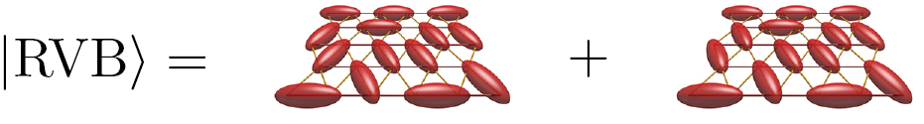
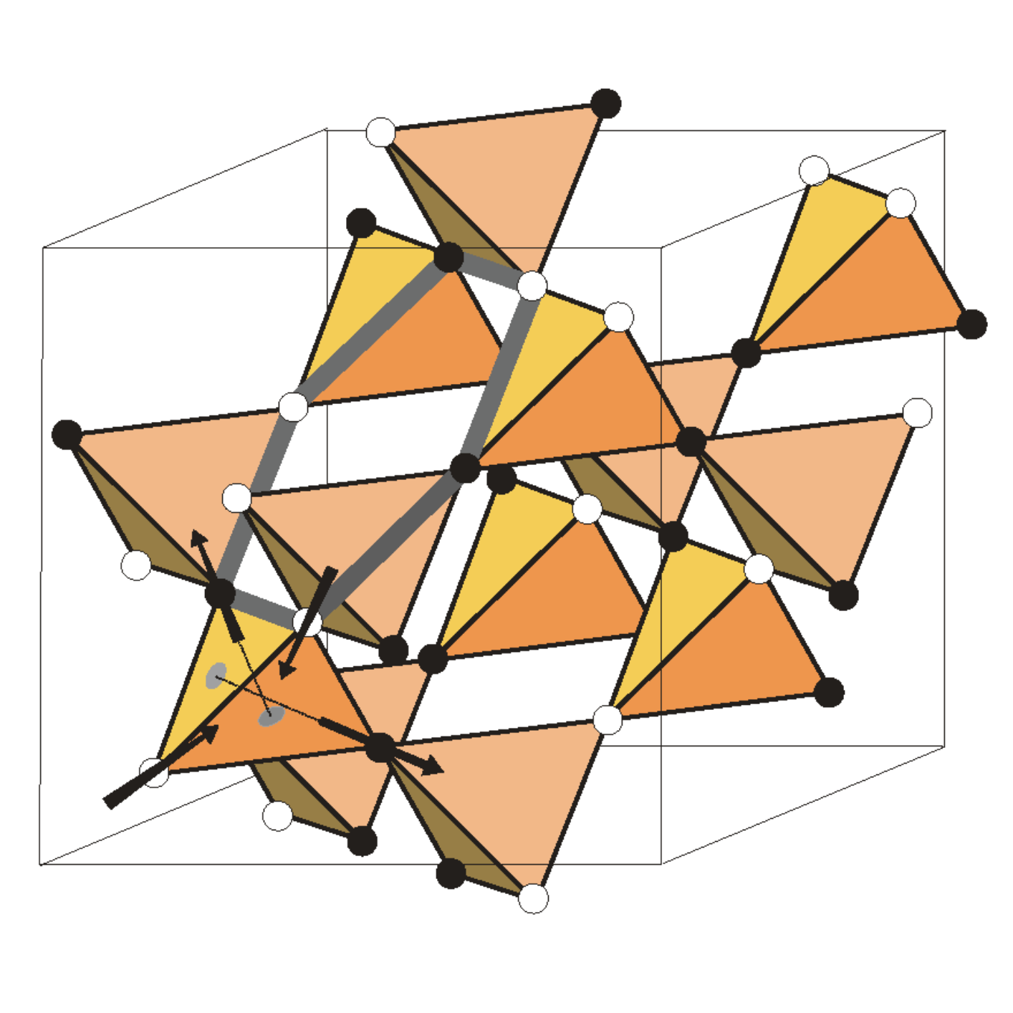
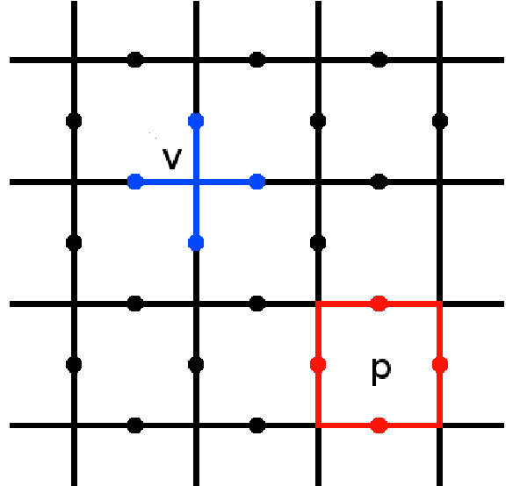
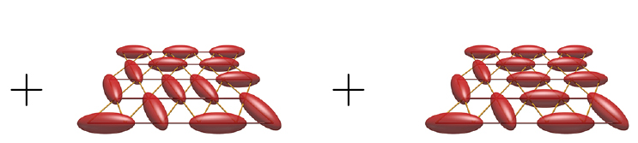
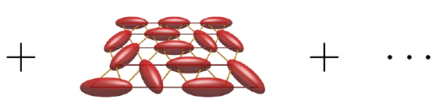
Spin liquids
Transverse Field Ising Model
Spin Liquids have No magnetic order
and are Not a product state
SLs are massively entangled paramagnets
Ferromagnet
Paramagnet
Resonating Valence Bond
Quantum Spin Ice
Toric Code
References: Savary & Balents, Rep. Prog. Phys. 2017
Notes:
The first time that I learned about Spin Liquids was actually at a summer school in Trieste back in August 2012

Slide 4
Quench
Time evolution following a rapid change of external parameters
‘Standard’ many-body theory describes ground state + excitations
but for a quench this is inadequate: need whole spectrum
Main questions: Will become a thermal state?
Can we have intermediate novel phases?
Ising Conformal Field Theory
Nonequilibrium Superconductivity
References: Cardy, Phys. Rev. Lett. 2014; Mitrano et al., Nature 2016
Notes:
Obvious technological applications but (for me) beautiful theory

Slide 5
Quenching the Kitaev chain
Return amplitude
looks very similar to
so we can construct “dynamical free energy”
Phase transition = breakdown of high-temperature expansion
Dynamical phase transition = breakdown of short-time expansion
Only happens if you quench
through a quantum phase transition
Shown here: Quench from Ferromagnet
to Paramagnet
References: Heyl, Polkovnikov & Kehrein, Phys. Rev. Lett. 2013

Slide 6
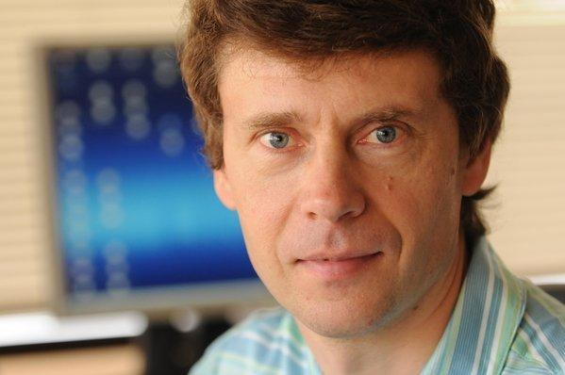
Quenching a Spin Liquid
Can we quench from a magnetically ordered state to a spin liquid?
Do we get a dynamical topological phase transition?
Intermediate non-equilibrium topological phase?
What is the thermalization timescale?
Do this with the Kitaev honeycomb model
(not to be confused with K-chain, SYK, Toric code…)

Slide 7
Kitaev honeycomb model
Spin is represented by 4 Majorana operators
Z₂ gauge fields are conserved
Hamiltonian is free ‘matter’ Majorana’s
References: Kitaev, Annals of Physics 2006

Slide 8
Kitaev honeycomb model (2)
Conserved ‘flux’
Ground state has
zero flux:
(toric code)
References: Kitaev, Annals of Physics 2006

Slide 9
Quench from initial Néel state
Take initial product state
Polarized along z-axis
Need to express Néel state in basis of gauge fields + matter Majorana’s
Superposition of all flux configurations
Trick: Physical spin is
This is gauge equivalent to (recall )

Slide 10
The initial Néel state
Eigenstate of , so two gauge field configurations contribute that differ a flip of two neighboring x/y gauge fields
Constraint 1: so
Constraint 2:
Conclusion: Equal weight superposition of gauge field configurations, with initial matter field fixed by
1
2

Slide 11
Time evolution
Time evolution is sum over gauge field configurations
Compute this sum using Monte Carlo sampling of
Given the matter fermions time evolve with Bogoliubov-De Gennes Hamiltonian with and
Used particle-hole transformation so that initial state is a-vacuum

Slide 12
Return amplitude
Dynamical phase transition? Look at return amplitude
Write BdG Hamiltonian in canonical form
Diagonalize the matrix with orthogonal
Use Balian-Brezin decomposition, , to find
References: Balian & Brezin, Il Nuovo Cimento B 1969

Slide 13
Return amplitude (2)
MC sampling of L=8 system to get ‘free energy’ density
Start of steady state
Exponentially long
prethermalization?

Slide 14
Magnetization
Staggered magnetization
Does not affect matter fermions, so this can be written as
where and differ by two gauge field flips.
Balian-Brezin decomposition + Sylvester Determinant lemma gives
(with and )

Slide 15
Magnetization (2)
Magnetization vanishes but even slower!
Exponentially long
Notes:
No clear transition when going into the ‘gapped’ phase – this is not relevant for such high-energy states we are considering here.
Exponentially slower

Slide 16
Prethermalization
Non-equilibrium state persists for exponentially long time in
Prethermalization:
with
We have ‘approximately conserved’
for
The is the z-bond coupling, that causes a ‘lock-in’ of the spin correlations along that bond.
The describes interactions between the ‘spin-locked’ bonds.
References: Abanin et al., Commun. Math. Phys. 2017

Slide 17
Prethermalization (2)
Approximate ‘lock-in’ of the spins along z-bond.
4th order perturbation theory
Manipulate the lattice to find Toric Code
Prethermal plateau is described by effective toric code with antiferromagnetic spin-lock along z-bonds!
(Note: Kitaevs derivation was for the ground state manifold with ferromagnetic spin-lock)
References: Kitaev, Annals of Physics 2006, Section 5 (Properties of the gapped phases)

Slide 18
Static correlations
Spin-lock even appears in the isotropic case
Nonzero steady state value confirms spin-lock
Dimer correlations
are exactly square of steady state spin correlations

Slide 19
Static correlations (2)
Steady state has spin-lock and zero magnetization
Suggested steady state is diagonal ensemble
Directly follows that because is off-diagonal
Static correlations are given by
Results with correspond to exact result at

Slide 20
Valence bond solid
Static spin and dimer correlations suggest steady state is
Valence Bond Solid (VBS)
Transition from Néel to VBS is known as ‘deconfined quantum critical’
because it falls outside Landau classification of phase transitions
However, we have not a ‘dynamical’ deconfined phase transition:
  There is no dynamical phase transition (remember return amplitude)
  Valence bond solid does not spontaneously break translational symmetry; the VBS is set by the direction of the initial Néel state
What happens when initial Néel state is not along canonical axes?
References: Senthil et al., Science 2004

Slide 21
Dynamical correlations
Two-time spin correlation function
can reveal excitations
For each gauge field configuration we now have time evolution with three different BdG Hamiltonians!
Repeated use of Balian-Brezin decomposition gives
Notes:
Just to show off, the previous slide didn’t have any equations in it.

Slide 22
Dynamical correlations (2)
Fourier transform the second time to see excitation spectrum
Dynamic spin-correlation reversal is a signature of a VBS triplet excitation
Width of Majorana density of states

Slide 23
What’s next?
Measure growth of entanglement
Different initial states:
  Néel order polarized along the (111) direction?
  Spiral magnetic order as seen in experiments of honeycomb-like materials?
Break integrability like in Kitaev-Heisenberg model?
Directly probe anyons in the prethermalized toric code?
References: Yao & Qi, PRL 2010 (entanglement); Biffin et al., PRL 2014 (zigzag); Chaloupka et al., PRL 2013 (KH model); Kitaev, Ann. Phys. 2003 (toric code)

Slide 24
Conclusions
Quenching the Kitaev honeycomb model:
  Initial Néel state is superposition of all flux configurations
  No dynamical phase transition
  Prethermalized plateau for anisotropic interactions with effective toric code
  Final steady state is valence bond solid
References: Louk Rademaker, (hopefully) soon on the arXiv 2017

