Slide 1

Fake Insulators
What are they, and how to spot them?
Louk Rademaker, SPICE, 26 May 2022
INSULATORS!!!

Slide 2
Metal vs. Insulator
T=0
T>0
activated
Critical: constant (25.8 kΩ)
Fermi liquid
Ref: Dobrosavljevic et al., Conductor-Insulator Quantum Phase Transitions (CUP 2012)
Notes:
\rho \sim e^{\Delta/T}

Slide 3
ABC Trilayer Graphene on hBN
ABC trilayer graphene: k³ dispersion
tune displacement field (D) & density (n)
hBN substrate: flat moiré bands
Ref: Chen Nature 2019; Chen Nature 2020
Notes:
\rho \sim e^{\Delta/T}

Slide 4
Metal-Insulator Transition
Resistivity as a function of temperature and displacement field
“insulator”
metal
Critical D_{c}
Ref: Chen, unpublished (2022)
Notes:
\rho \sim e^{\Delta/T}

Slide 5
Insulator side
Arrhenius plot to extract
insulating gap
Gap dependence on
displacement field
… but it’s WRONG!!
NO activated behavior at low T!
Notes:
\rho \sim e^{\Delta/T}

Slide 6
Fake insulators are everywhere
Twisted bilayer graphene
Twisted double
bilayer graphene
Twisted bilayer
WSe2
Ghiotto Nature 2021
Szentpéteri Nano Lett 2021
Cao Nature 2018; Lu Nature 2019
Notes:
\rho \sim e^{\Delta/T}

Slide 7
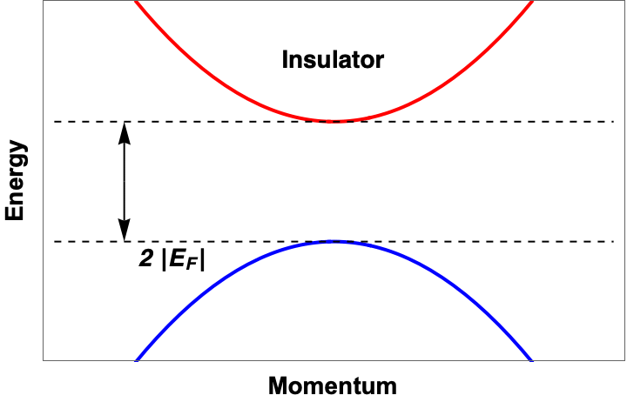
Band theory of MIT: Kubo formula
Current operator
Kubo formula:
(w/o vertex)
Density of states
Fermi function
Apply to band transition:
Density of states
with weak disorder
Drude formula
Particle density
Scattering rate
Effective mass
Notes:
\rho \sim e^{\Delta/T}

Slide 8
Band theory of MIT: Exact Solution
Insulator: activated
Critical: not constant
Metal: negative slope!
“fake insulator”
Notes:
\rho \sim e^{\Delta/T}

Slide 9
Band theory of MIT: Scaling
Exact solution
has scaling form
leading to universal resistivity curves
close to the metal-insulator transition
Notes:
\rho \sim e^{\Delta/T}

Slide 10
Application: MoTe₂/WSe₂
Aligned TMD heterobilayer
MoTe₂/WSe₂
Bandwidth can be tuned by displacement field
Ref: Li, Nature (2021)
Notes:
\rho \sim e^{\Delta/T}

Slide 11
Scaling in MoTe₂/WSe₂
Extrapolating the zero-temperature conductivity and insulating gap gives critical D_{c}
With scaling of the resistivity curves
Critical curve
Fake
insulator
Ref: Li, Nature (2021); Tan, Tsang, Dobrosavljevic, arXiv:2112.11522 (2021)
Notes:
\rho \sim e^{\Delta/T}

Slide 12
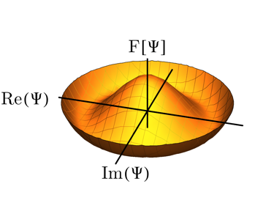
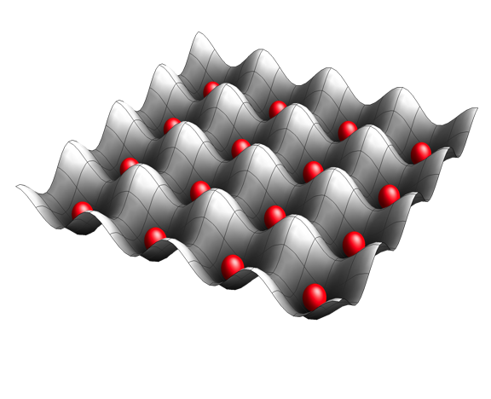
Insulators at half-filling
Mott insulator
Spontaneous Symmetry Breaking
Notes:
\rho \sim e^{\Delta/T}

Slide 13
Simplest example: Stoner ferromagnetism
Ferromagnetic direct exchange
Spontaneous polarization shifts bands for up/down spins
Self-consistent Stoner mean field theory
Metal-insulator transition when m J = W (bandwidth)
from itinerant partially polarized ferromagnet
to insulating fully polarized ferromagnet
Notes:
\rho \sim e^{\Delta/T}

Slide 14
Resistivity scaling near SSB-MIT
Resistivity close to “full polarization MIT” displays “fake insulators” and scaling
Critical curve
Metallic region with
Notes:
\rho \sim e^{\Delta/T}

Slide 15
Application: ABC Trilayer Graphene
ABC trilayer graphene is ferromagnetic:
Observed curves never diverge as 1/T
This is how a critical curve would look like
Hypothesis:
all resistivity curves correspond to the
metallic side of a full polarization transition!
Ref: Zhou Nature 2021; Chen (unpublished 2022)
Notes:
\rho \sim e^{\Delta/T}

Slide 16
Scaling in ABC Trilayer Graphene
Indeed, all curves can be collapsed using a scaling ansatz of being close to MIT
“Distance to MIT” is
measured by
scaling parameter T₀
Zero T conductivity
will vanish when
T₀ vanishes
Ref: Chen (unpublished 2022)
Notes:
\rho \sim e^{\Delta/T}

Slide 17
Mott metal-insulator transition
Dilute 2DEGs
Mott organics
Half-filled MoTe₂/WSe₂
Ref: Tan, Dobrosavljevic, Rademaker, “How to recognize the universal aspects of Mott criticality?” (2022, soon on arXiv)
Notes:
\rho \sim e^{\Delta/T}

Slide 18
Mott metal-insulator transition in MoTe₂/WSe₂
Powerlaw critical resistivity curve , α = 1.2
No ”fake insulator” regime, but
Crossover scale T₀ signaling end of Fermi liquid with a
resistivity maximum
Insulator has continuous
vanishing gap Δ
Ref: Tan, Dobrosavljevic, Rademaker (2022, soon on arXiv); Li Nature 2021
Notes:
\rho \sim e^{\Delta/T}

Slide 19
Scaling near Mott metal-insulator transition
4. Perfect scaling of insulating and metallic curves
Ref: Tan, Dobrosavljevic, Rademaker, “How to recognize the universal aspects of Mott criticality?” (2022, soon on arXiv)
Notes:
\rho \sim e^{\Delta/T}

Slide 20
Theory of continuous Mott M-I-T
Ref: Tan, Dobrosavljevic, Rademaker, “How to recognize the universal aspects of Mott criticality?” (2022, soon on arXiv)
Notes:
\rho \sim e^{\Delta/T}

Slide 21
Caveats / Open problems
Fake fake insulators
Low temperature saturation in insulators can come from experimental issues
Ref: Falson, Nat Mater 2022
Anderson insulation?
Standard theory predicts Anderson insulation at low density in presence of disorder in 2d
Phonons? Electron-electron interactions?
Still work to do in including further interactions mechanisms.
Are there different universality classes associated with scaling close to the MIT?
Notes:
\rho \sim e^{\Delta/T}

Slide 22
Collaborators
Theory collaborators:
Experimental data from:
Vlad Dobrosavljevic & Yuting Tan
Florida State U, USA
Guorui Chen
Shanghai Jiao Tong U, China
Jie Shan, Kin Fai Mak
Cornell U, USA
Simone Fratini
Grenoble, France
Notes:
\rho \sim e^{\Delta/T}

Slide 23
Conclusions: A New Perspective on Metal-Insulator Transitions
Critical resistivity is not constant but diverges as a powerlaw
Close to the MIT there is a metallic regime with
(“fake” insulator)
Close to the MIT there is universal scaling of resistivity curves
Theory: weak disorder band transitions (with or without SSB)
Applicable to experiments in moiré systems (graphene, TMDs)
Mott MIT has different properties
Notes:
Take-home message:
- Critical curve is powerlaw NOT constant
- There is therefore a regime that is metallic yet drho/dT <0
- Close to the
- Both in case of band-transition as well as Mott MIT

Slide 24
Notes:
\rho \sim e^{\Delta/T}

Slide 25
Scaling in MoTe₂/WSe₂
Extrapolating the
zero-temperature conductivity
gives critical D_{c}
where the resistivity follows
scaling
Critical curve
Fake
insulator
Ref: Li, Nature (2021); Tan, Tsang, Dobrosavljevic, arXiv:2112.11522 (2021)
Notes:
\rho \sim e^{\Delta/T}

